Slide 1
4180/5180: Reinforcement Learning (and Sequential Decision Making) Introduction to RL Chris Amato Northeastern University with some slides from Rob Platt, Lawson Wong and Rich Sutton
Notes:
1

Slide 2
Some logistics
Class webpage: https://www.ccs.neu.edu/home/camato/4180_5180summaryF22.html
Office hours and TAs
Chris: Thursday 2-3:30pm or by Appt. in ISEC 522
TAs
Chengguang: Monday 2:00 pm – 3:30 pm (virtual)
Guanang: Wednesday 4:40-5:50 pm WVF 116
Mingxi: Friday 2:00–3:30 pm Room WVF 116
Piazza: http://piazza.com/northeastern/fall2022/cs41805180/home

Slide 3
Book
Required
Reinforcement Learning: An Introduction (2nd edition), http://incompleteideas.net/book/the-book-2nd.html
Extra
We’ll supplement with papers and other text for more advanced material

Slide 4
Readings
Posted on the website/syllabus
Please read the listed sections before class
Chapter 2 of SB due next class
Please read Chapter 1 as well (it is just an overview)

Slide 5
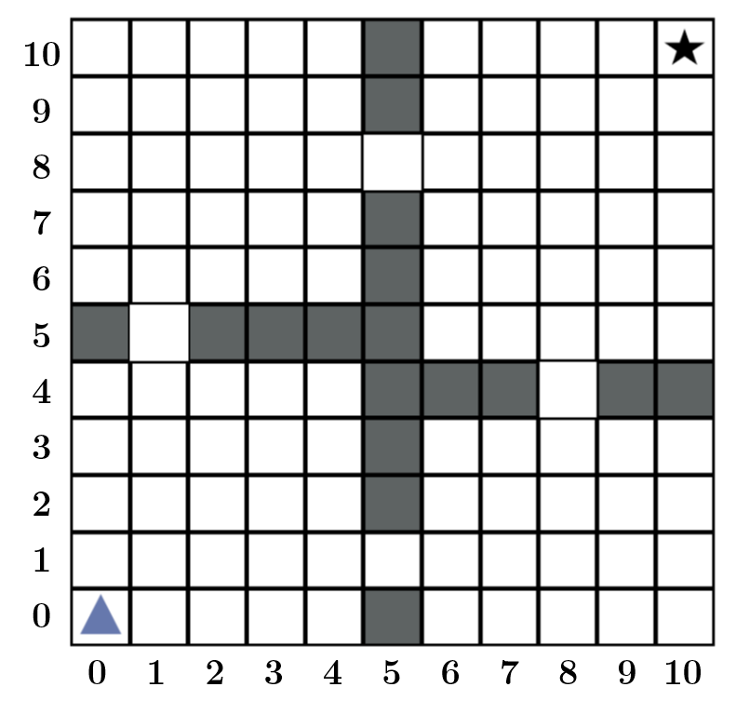
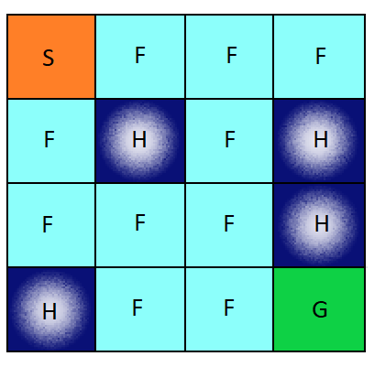
Exercises
A mix of written and programming problems (typically with Python and PyTorch)
Answer questions and code up RL algorithms to test on standard benchmarks
Can discuss problems with others, but each student should turn in their own answers
Due approximately weekly
The first one (just setting up) is due next Wednesday!

Slide 6
Exams
2 midterms
October 20
November 28
No final

Slide 7
Class Project
Apply an RL method to a problem of your choice or learn a new method
Conduct experiments and write up report (as a research paper)
Alone or in pairs
Present preliminary results during the last few classes

Slide 8
Grading
Exercises: 40%
Exams: 30%
Final project (presentation and paper): 30%

Slide 9
5180 vs. 4180
Lectures are the same
Exercises and exams will have questions that are required for 5180 and extra credit for 4180
More sophisticated projects for 5180
For both: Should have a strong programming and math (probability, calculus, linear alg) background to keep up
Complete self assessment from syllabus

Slide 10
Some topics covered
Function Approximation
Linear function approximation
Deep neural networks (DQN and extensions)
Policy Gradient Methods
Policy gradient formulation
REINFORCE
Actor-critic methods
Deep PG and AC methods (e.g., DDPG, PPO)
Problem formulation
The reinforcement learning problem, anatomy of an RL agent
Bandit problems
Markov decision processes (MDPs)
Value function methods
Monte Carlo Methods
Dynamic Programming
Temporal Difference Learning
Combining planning and learning
Monte Carlo Tree Search (MCTS)

Slide 11
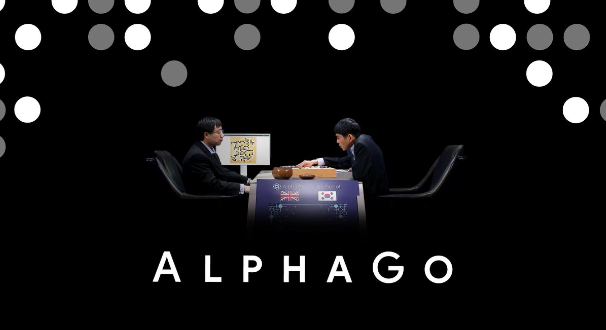
Excitement
https://www.youtube.com/watch?v=WXuK6gekU1Y

Slide 12
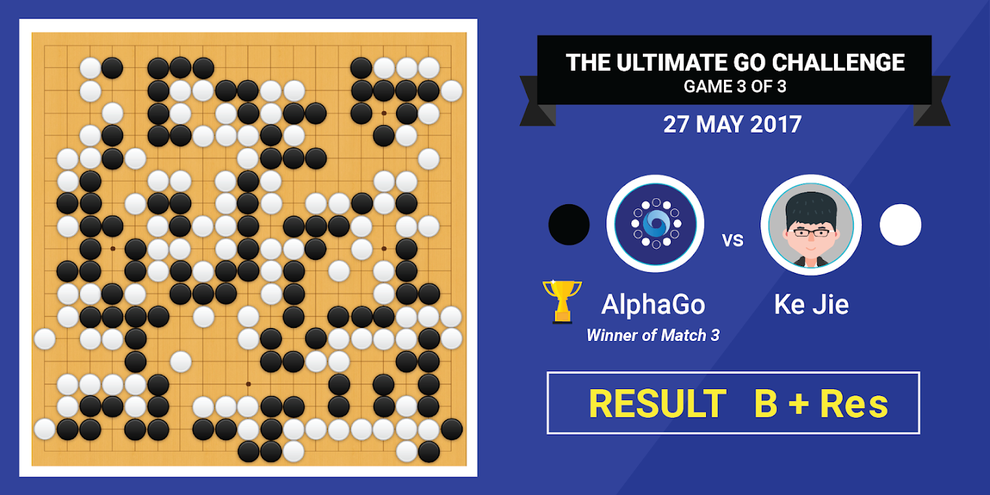
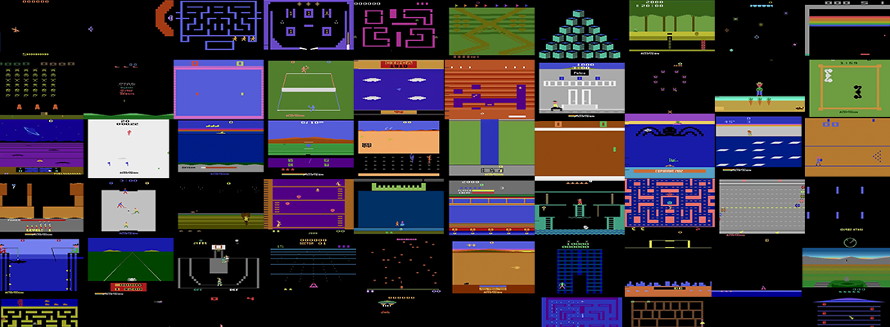
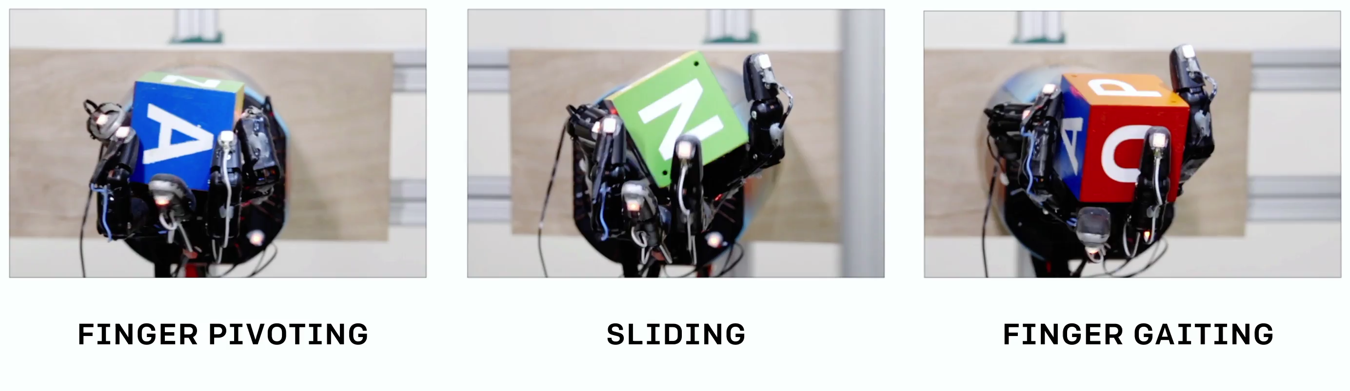
Reinforcement Learning Sucesses
Atari (Google DeepMind)
AlphaGo (Google DeepMind)
Google Nest
Robot manipulation (OpenAI)
AlphaStar (Google DeepMind)

Slide 13
More examples
Atari Breakout https://www.youtube.com/watch?v=TmPfTpjtdgg
Environments: OpenAI Gym
https://gym.openai.com/envs/
Learning locomotion in MuJoCo https://www.youtube.com/watch?v=SHLuf2ZBQSw
Learning to navigate in DeepMind Lab https://www.youtube.com/watch?v=M40rN7afngY
Cart-Pole swing-up on a real robot https://www.youtube.com/watch?v=XiigTGKZfks

Slide 14
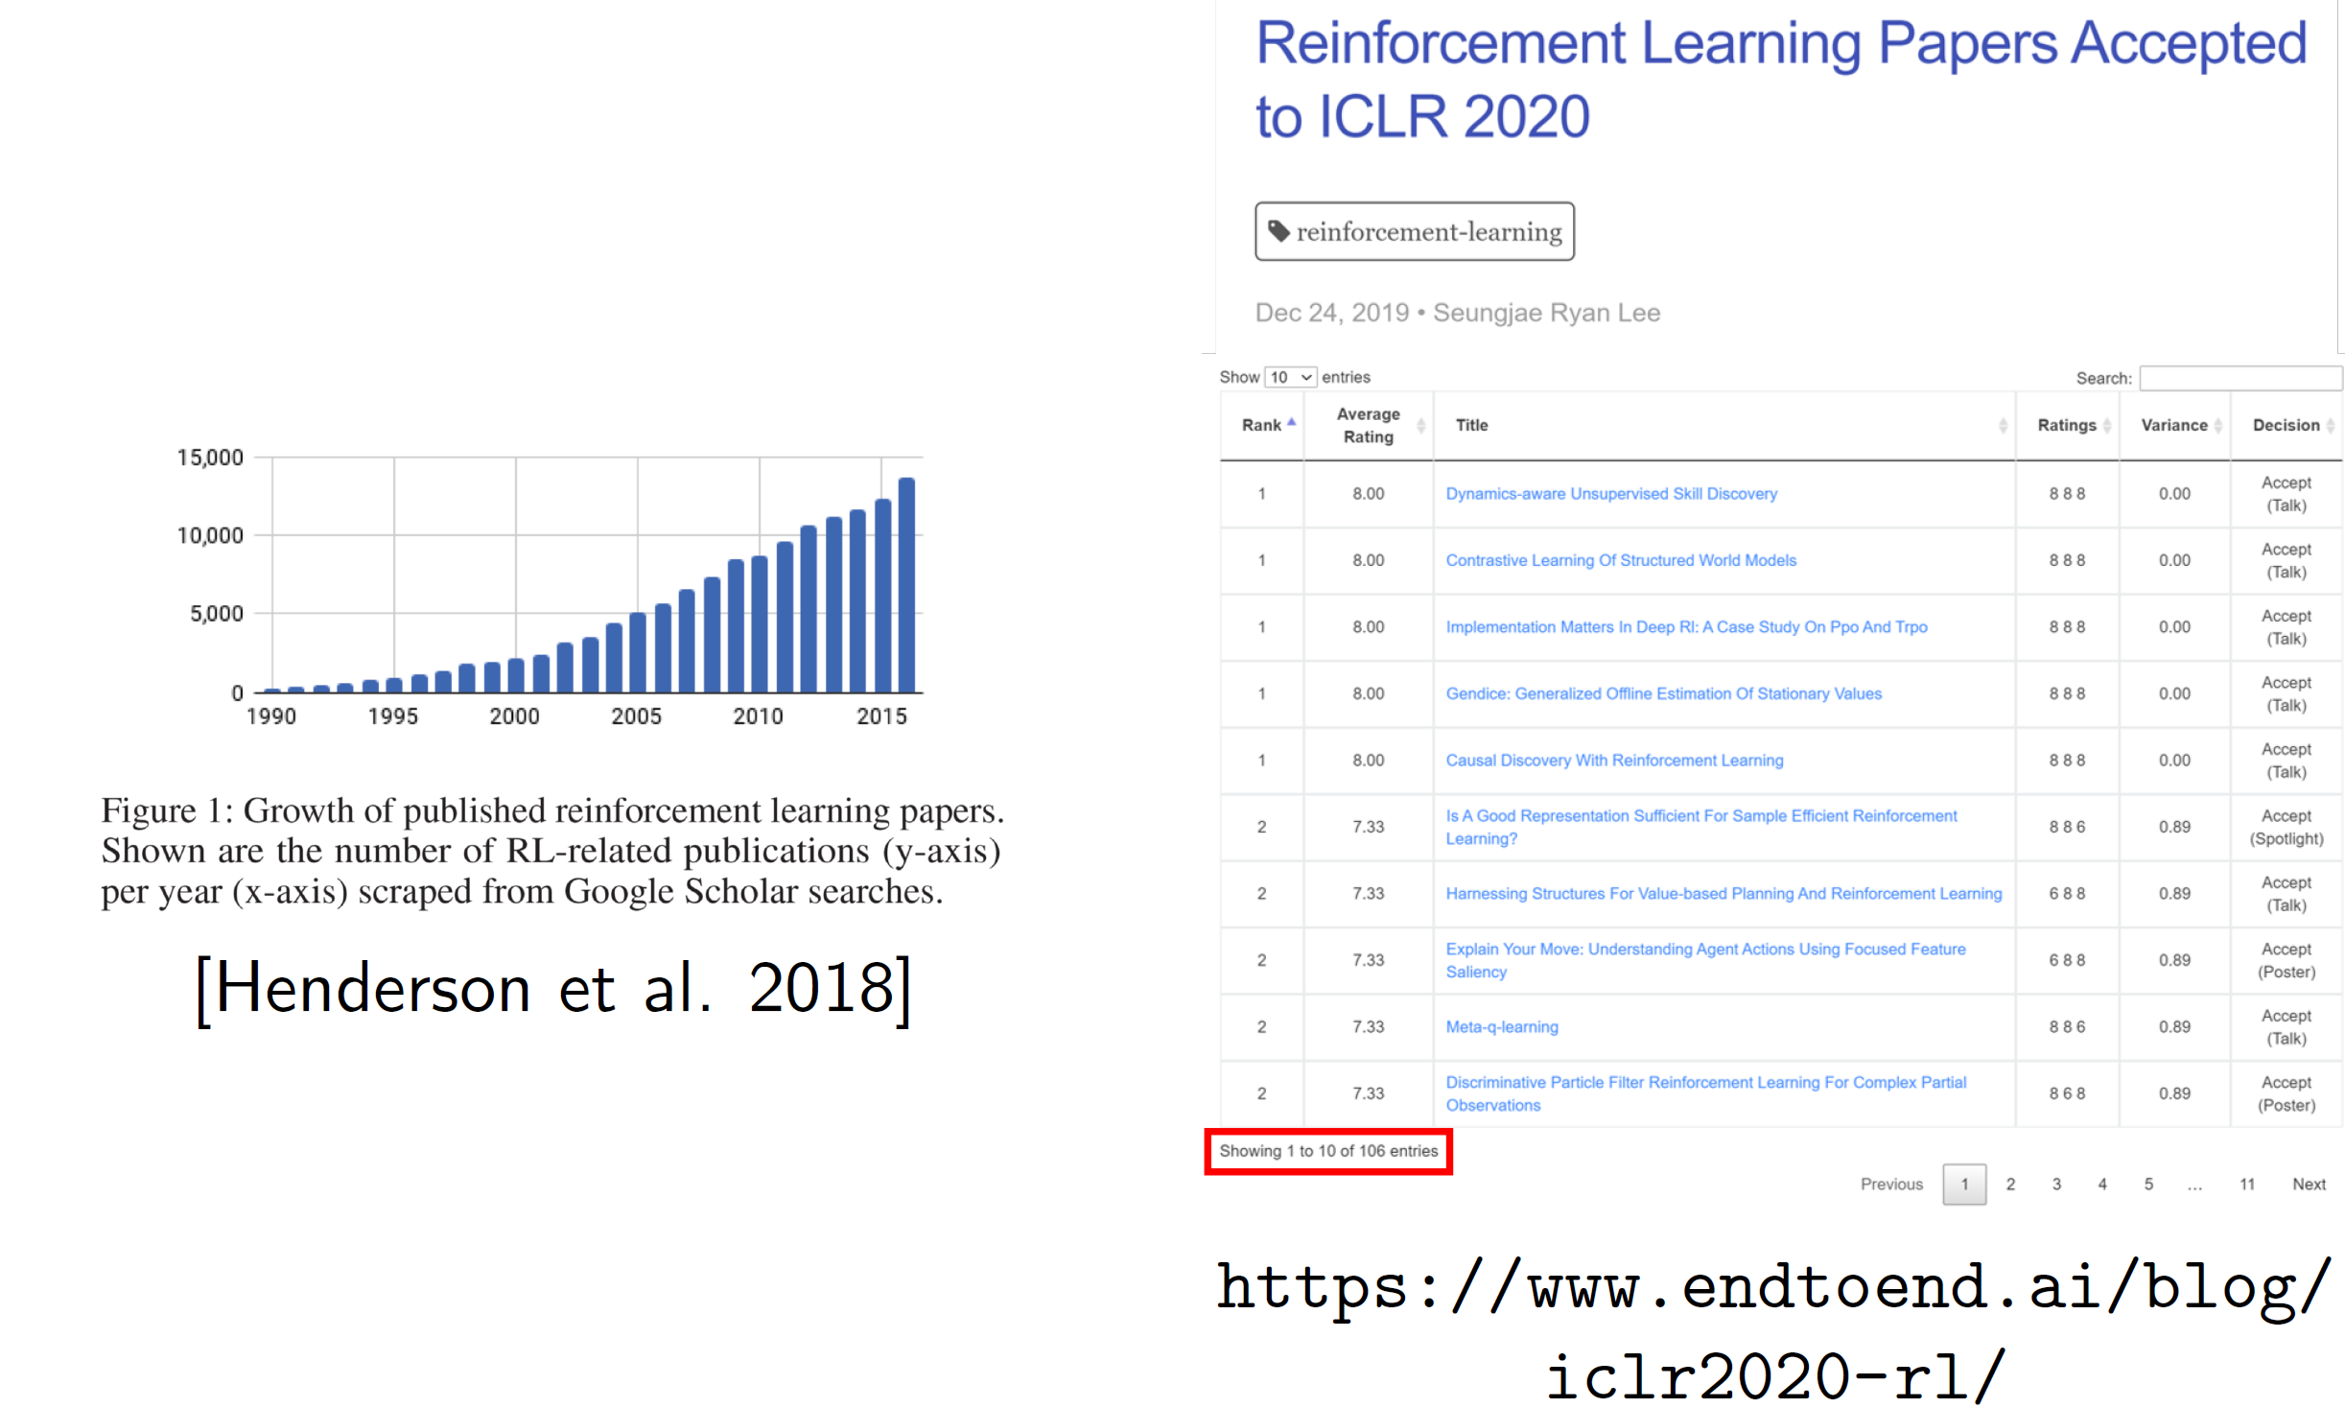
Excitement
15% of papers

Slide 15
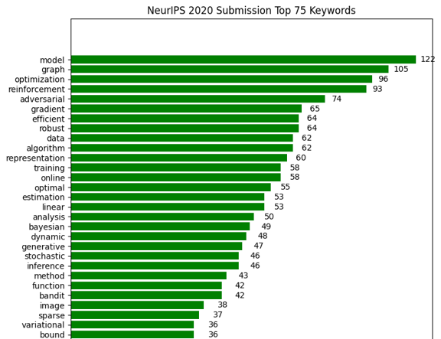
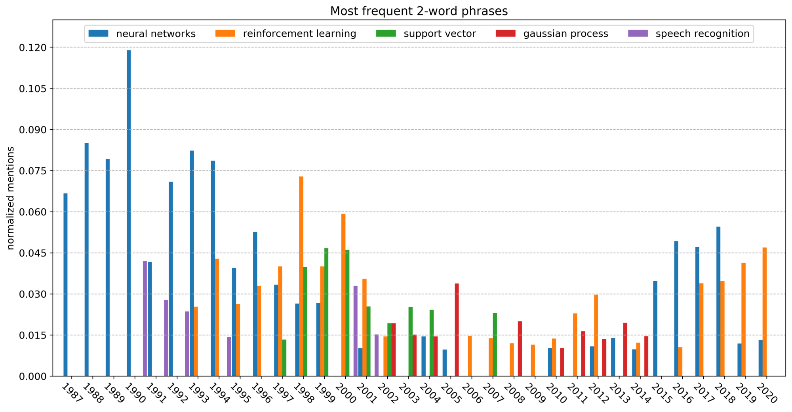
Excitement
Data from NeurIPS
…

Slide 16
What is RL? Machine Learning
Can we make predictions from data?
Don’t have a model of the world, but want to learn one or what to do

Slide 17
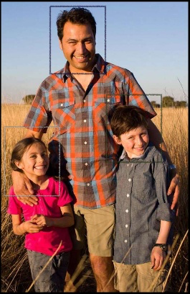
Supervised learning
Learning from labeled data

Slide 18
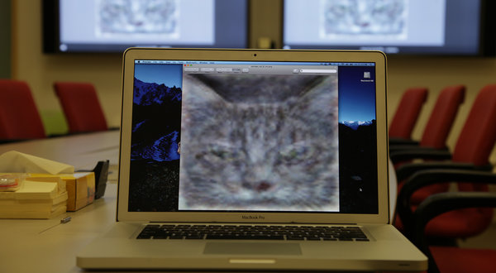
Unsupervised learning
Learning from unlabeled data

Slide 19
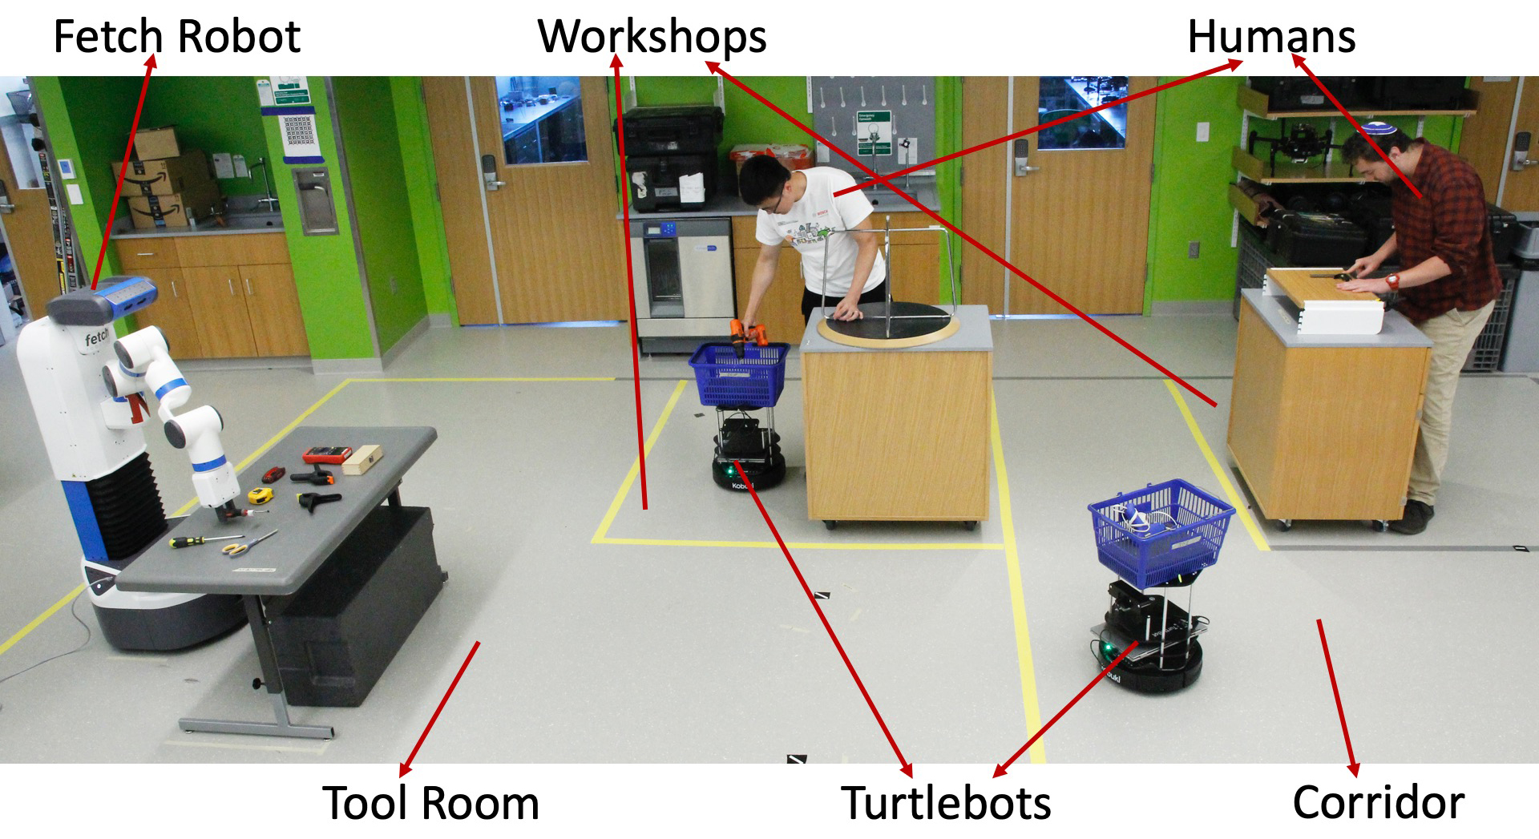
Reinforcement learning
Key characteristics:
Learning from (real-valued) feedback
Learning sequential decisions

Slide 20
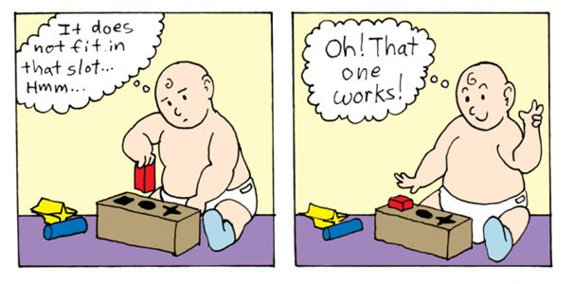
What is reinforcement learning?
RL is learning through trial-and-error without a model of the world
Notes:
20

Slide 21
What is reinforcement learning?
RL is learning through trial-and-error without a model of the world
Like an idealized computational model of how humans learn
Notes:
21

Slide 22
The RL setting
Action
Agent
World
State
Reward
On a single time step, agent does the following:
1. observe some information (e.g., the state)
2. select an action to execute
3. take note of any reward
Goal of agent: select actions that maximize expected cumulative reward
Notes:
22

Slide 23
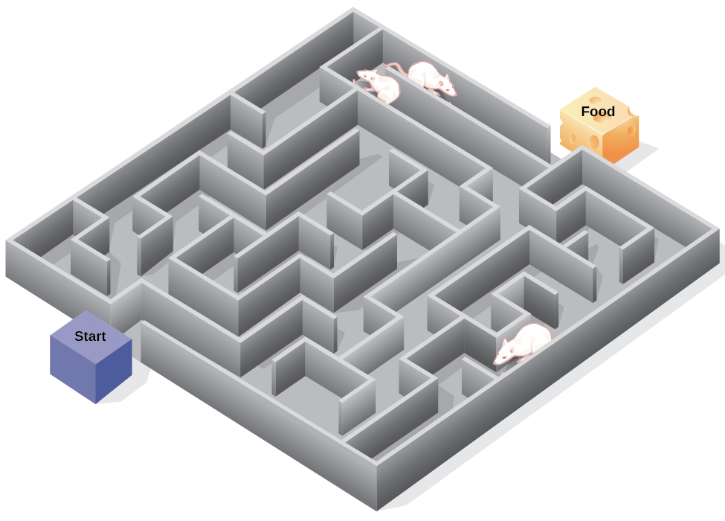
Example: rat in a maze
Move left/right/up/down
Agent
World
Observe position in maze
Reward = +1 if get cheese
Goal: maximize cheese eaten
Notes:
23

Slide 24

Example: robot makes coffee
Move robot joints
Agent
World
Observe camera image
Reward = +1 if coffee in cup
Goal: maximize coffee produced
Notes:
24

Slide 25
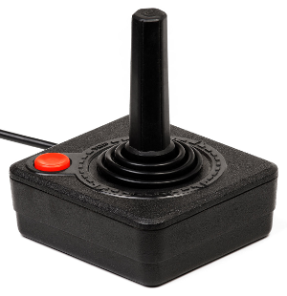
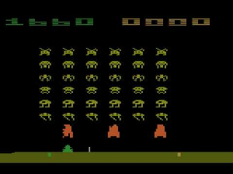
Example: agent plays pong
Joystick command
Agent
World
Observe
screen pixels
Reward = game score
Goal: maximize game score
Notes:
25

Slide 26
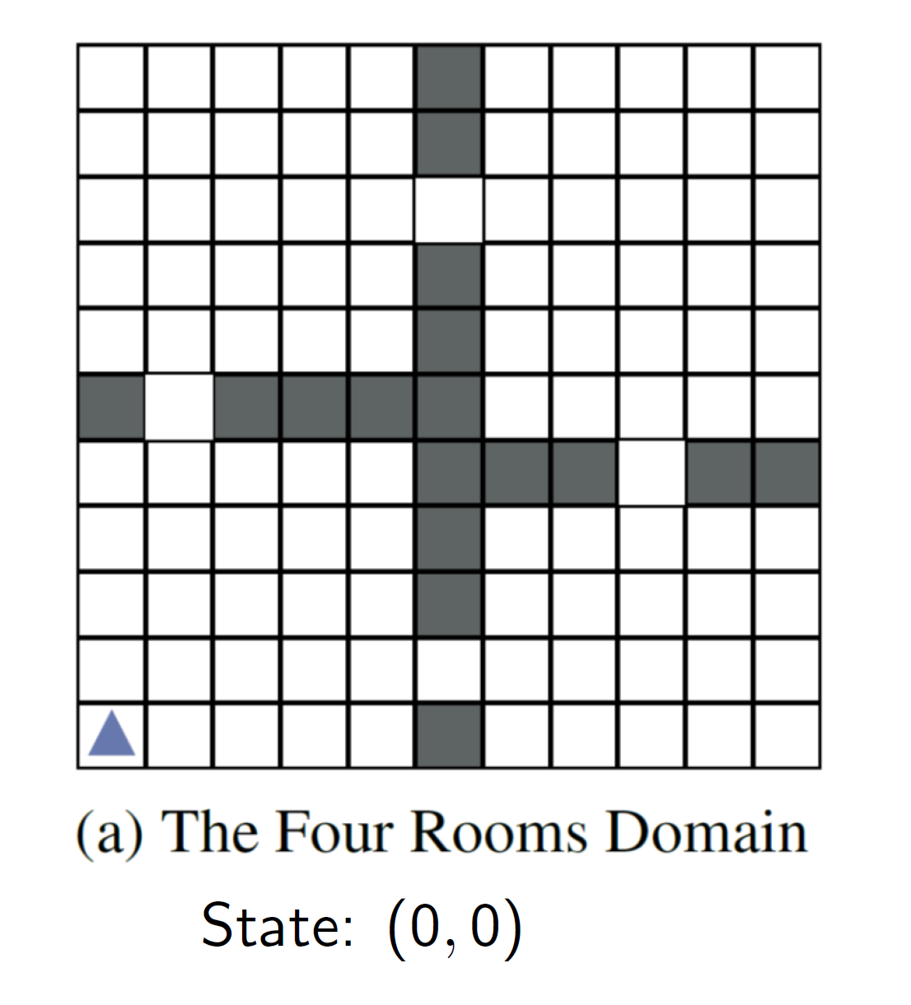
What is reinforcement learning?

Slide 27
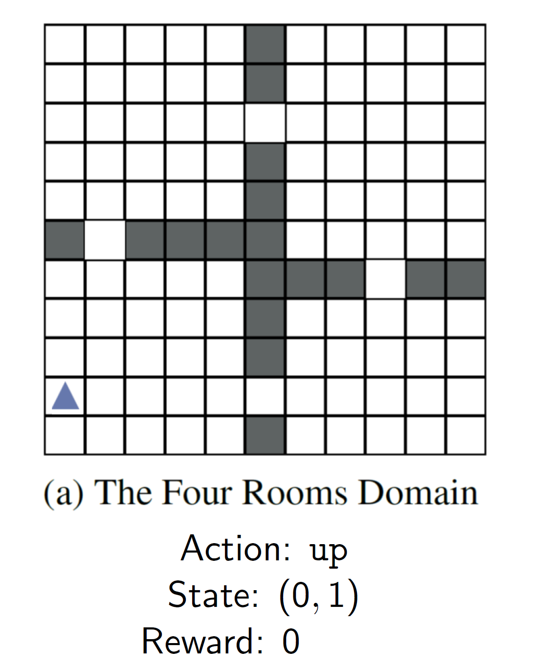
What is reinforcement learning?

Slide 28
What is reinforcement learning?
Sometimes the world has noise (effects of actions are stochastic)

Slide 29

What is reinforcement learning?
Sometimes the world has noise (effects of actions are stochastic)

Slide 30
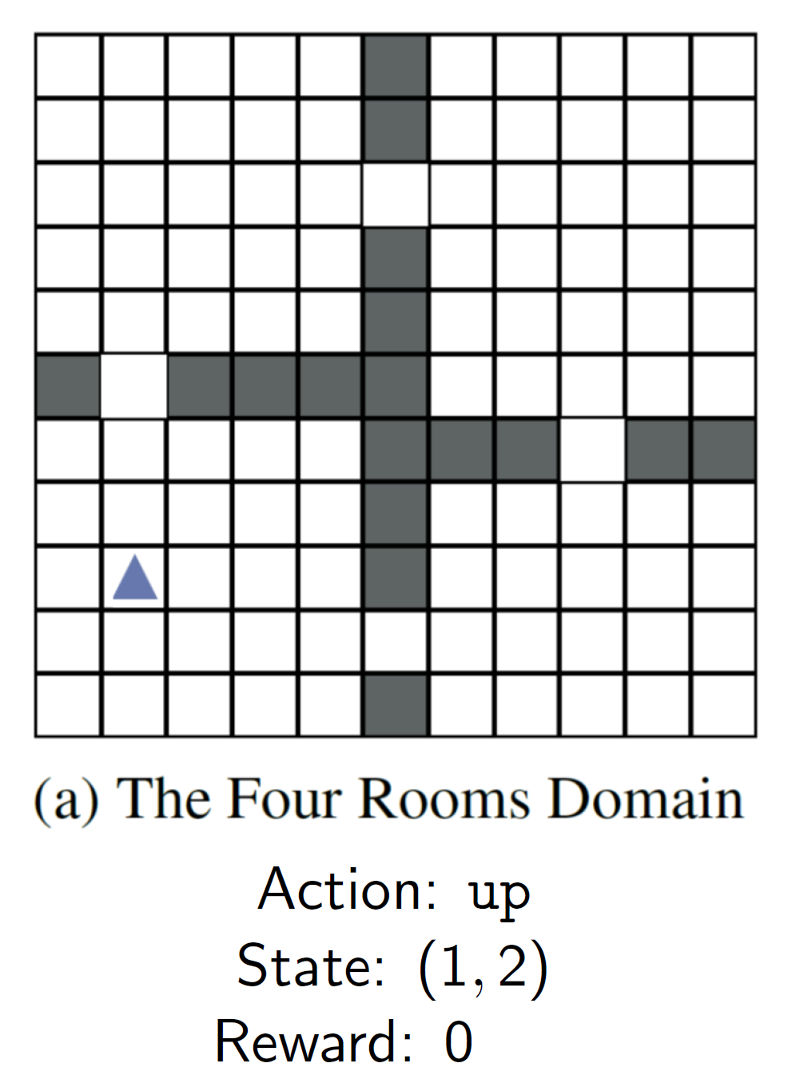
What is reinforcement learning?

Slide 31
What is reinforcement learning?
(Many time steps later…)

Slide 32
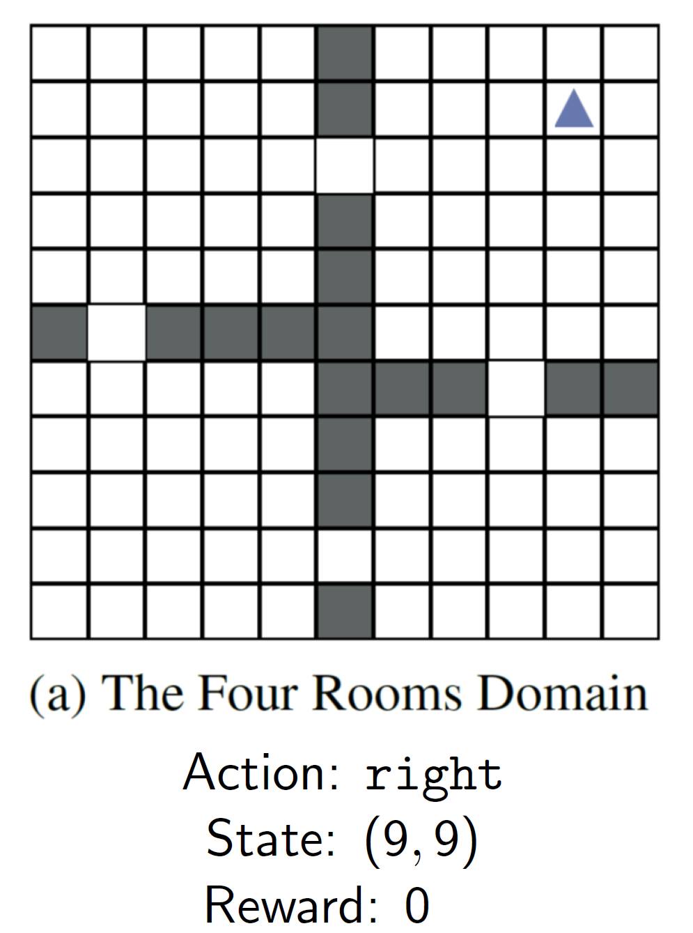
What is reinforcement learning?

Slide 33

What is reinforcement learning?

Slide 34
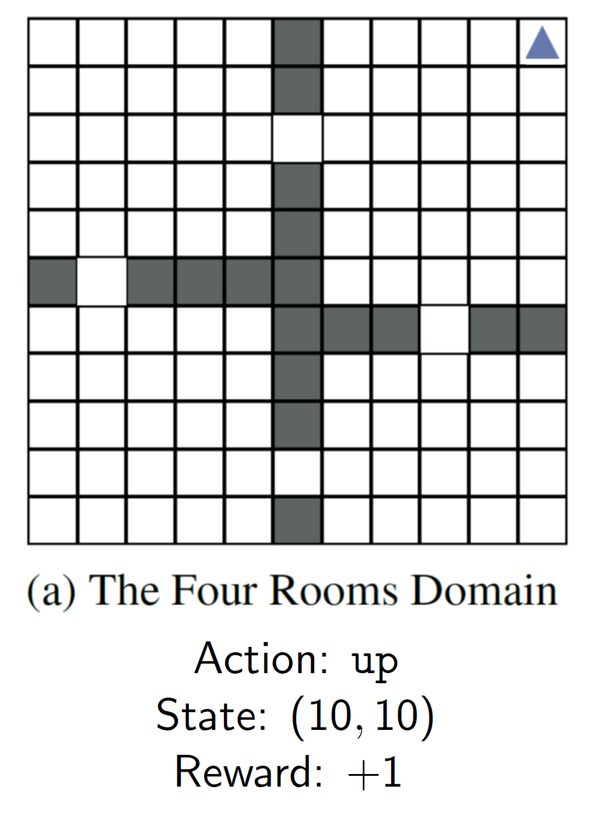
What is reinforcement learning?

Slide 35
What is reinforcement learning?
(Reset and try again)

Slide 36
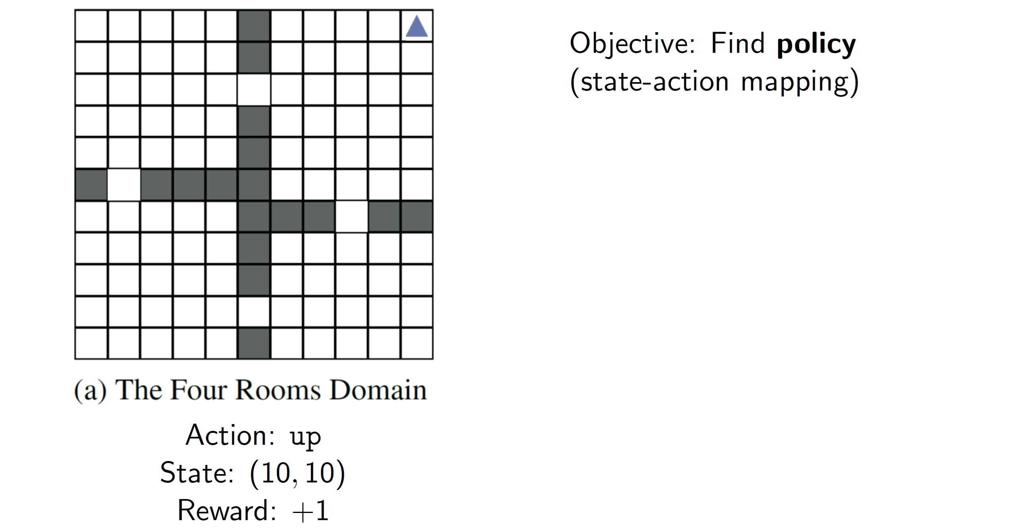
What is reinforcement learning?

Slide 37
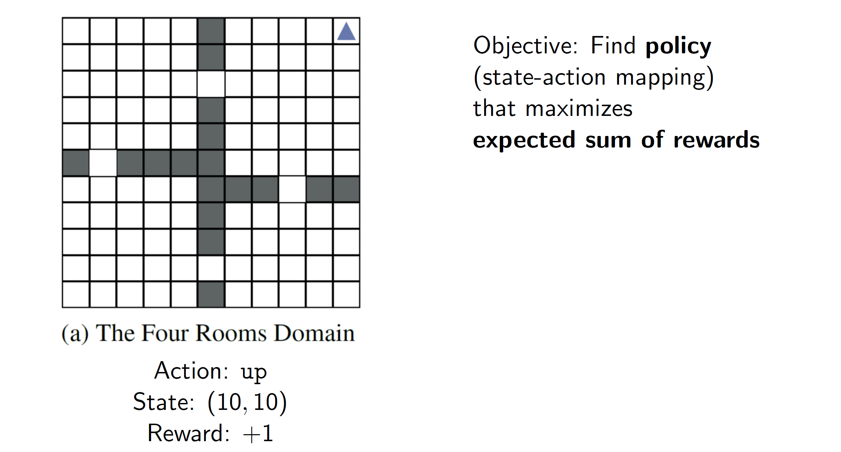
What is reinforcement learning?

Slide 38
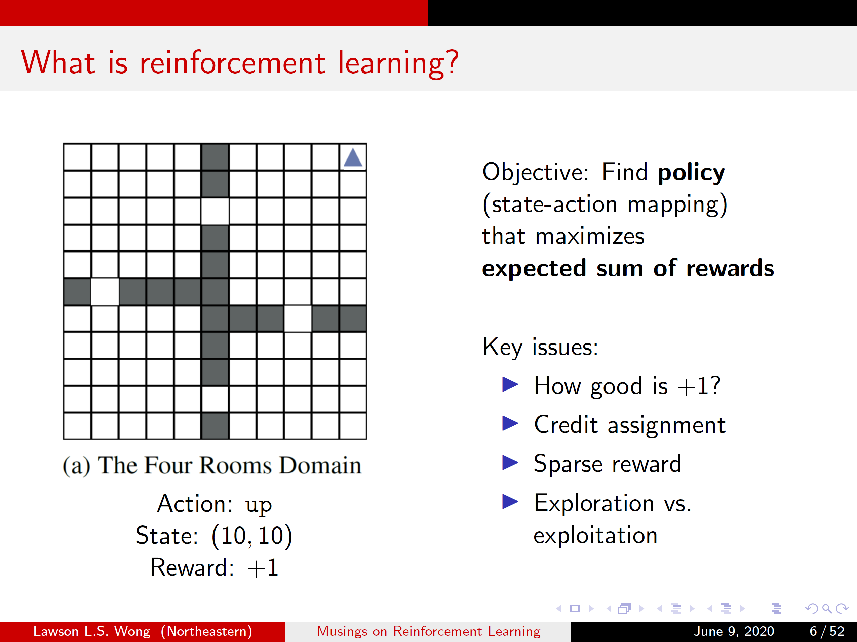
What is reinforcement learning?

Slide 39
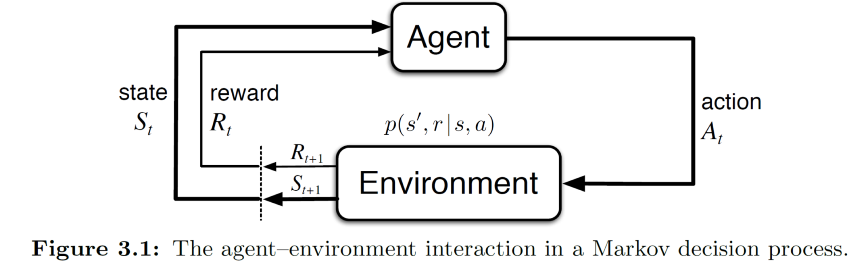
Technical intro to RL

Slide 40
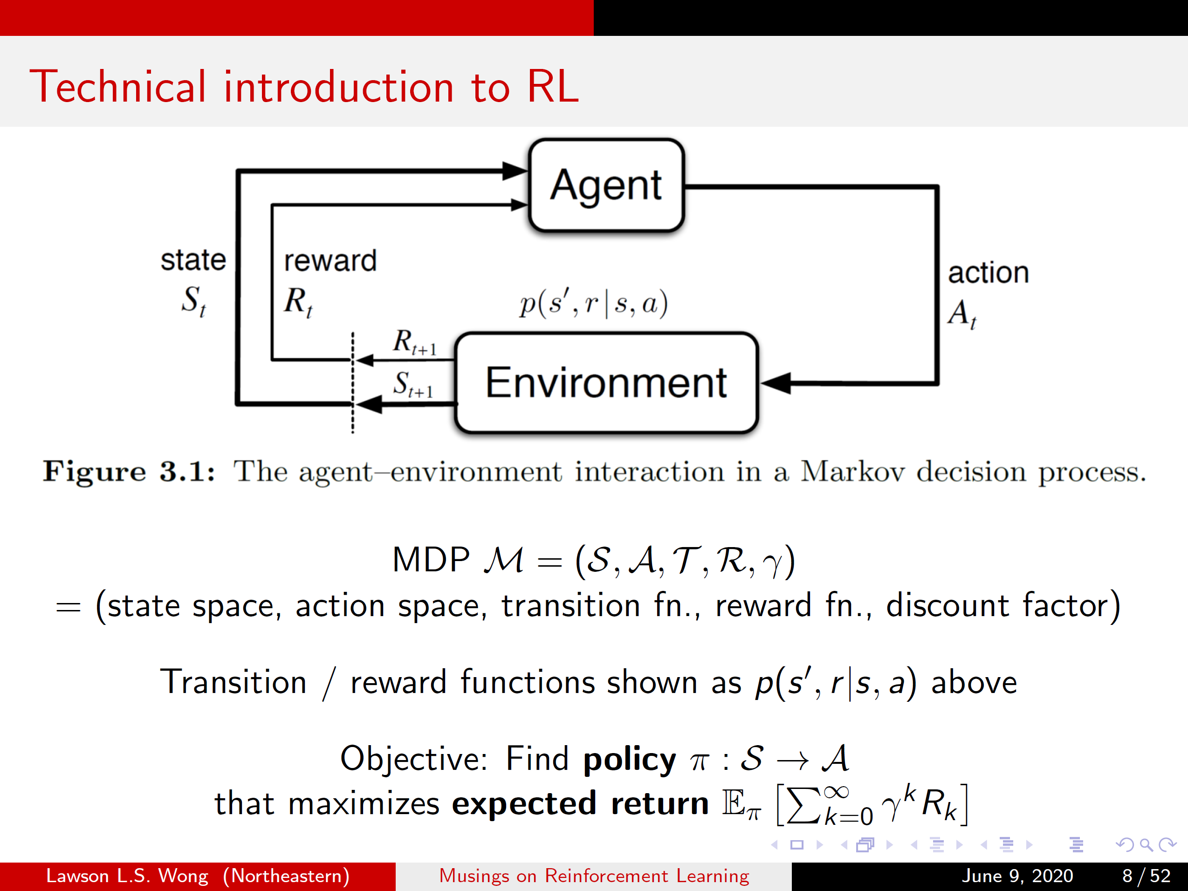
Technical intro to RL

Slide 41
Technical intro to RL

Slide 42
Technical intro to RL

Slide 43
Technical intro to RL

Slide 44
What is RL?

Slide 45
Interlude
Reinforcement learning is very general and has demonstrated promise
However, RL is a very challenging problem and is still very much a research field

Slide 46
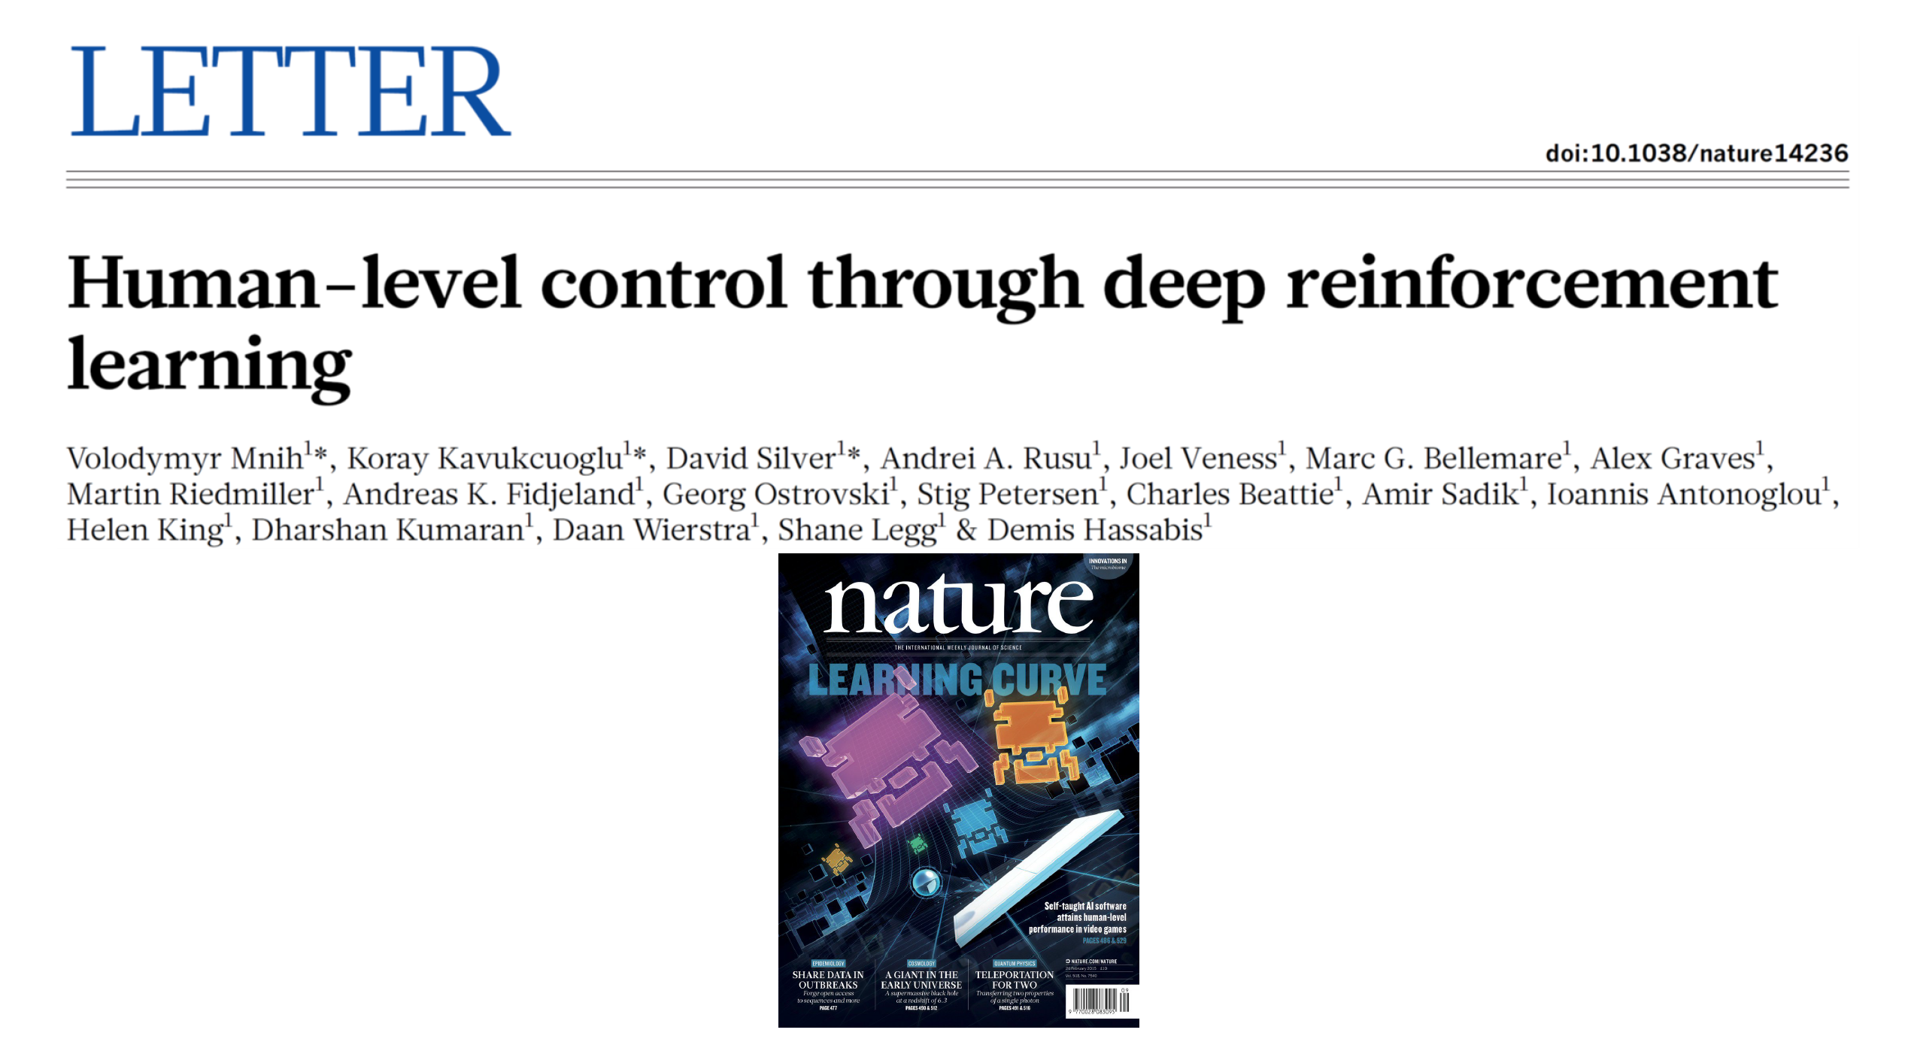
Deep Q-networks (DQN) (2015)

Slide 47
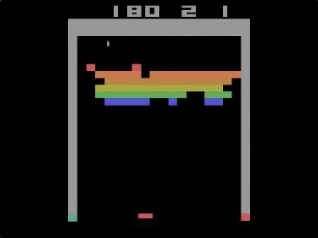
DQN on Breakout

Slide 48
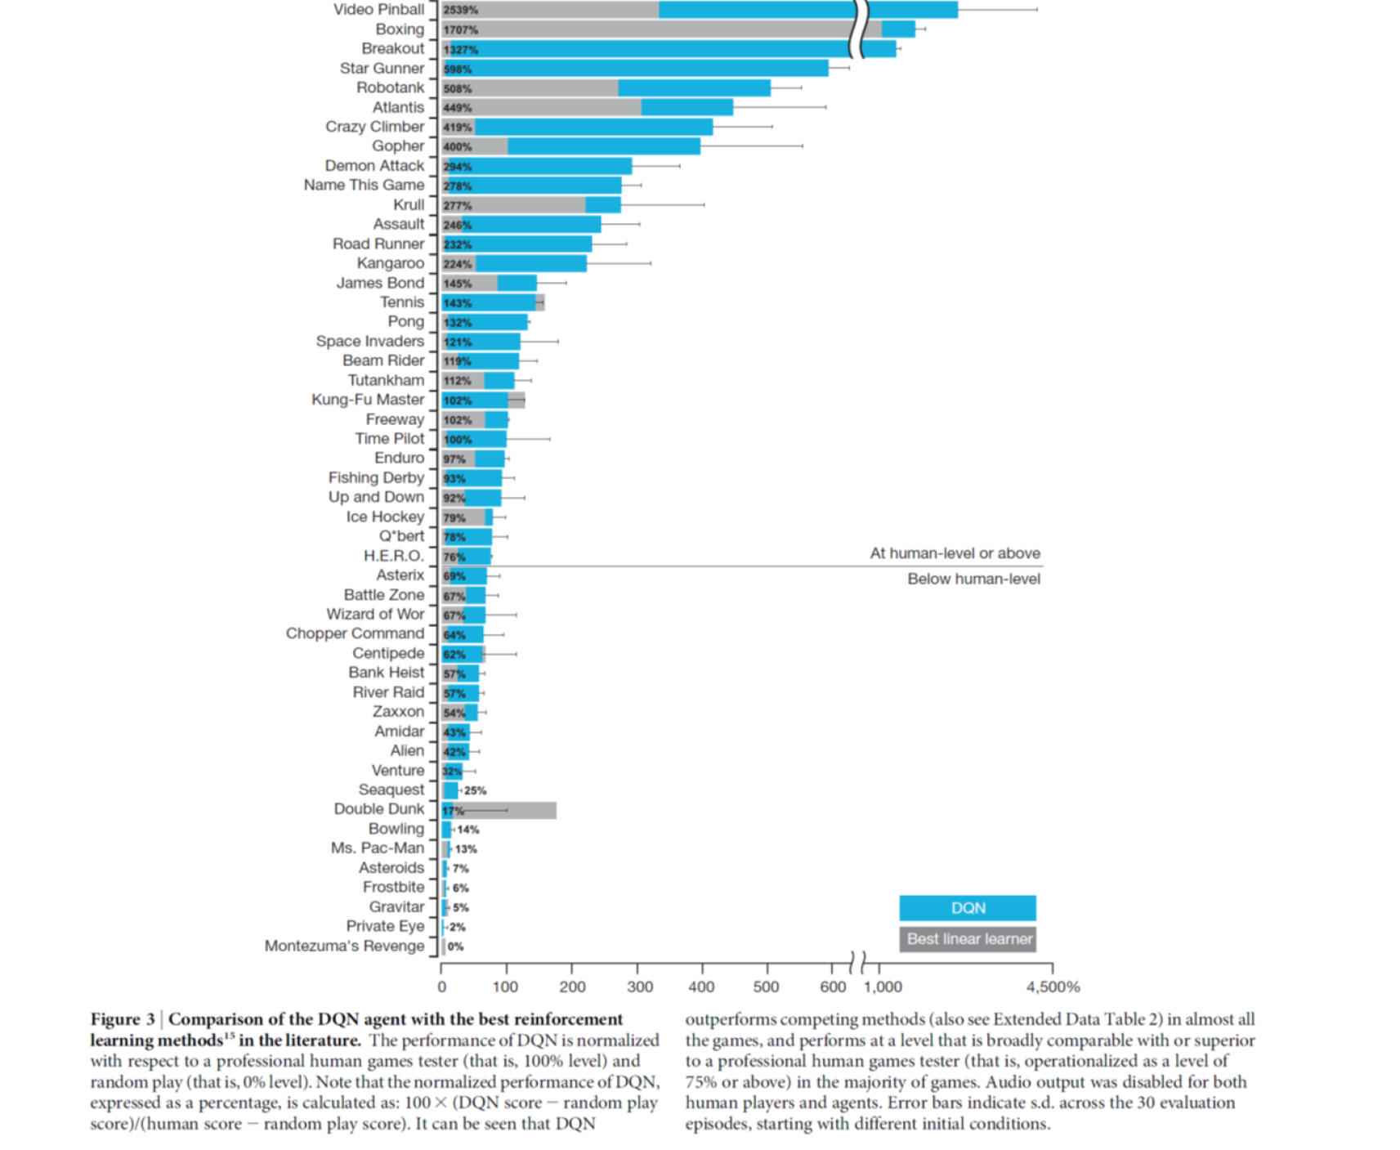
Are we done?

Slide 49
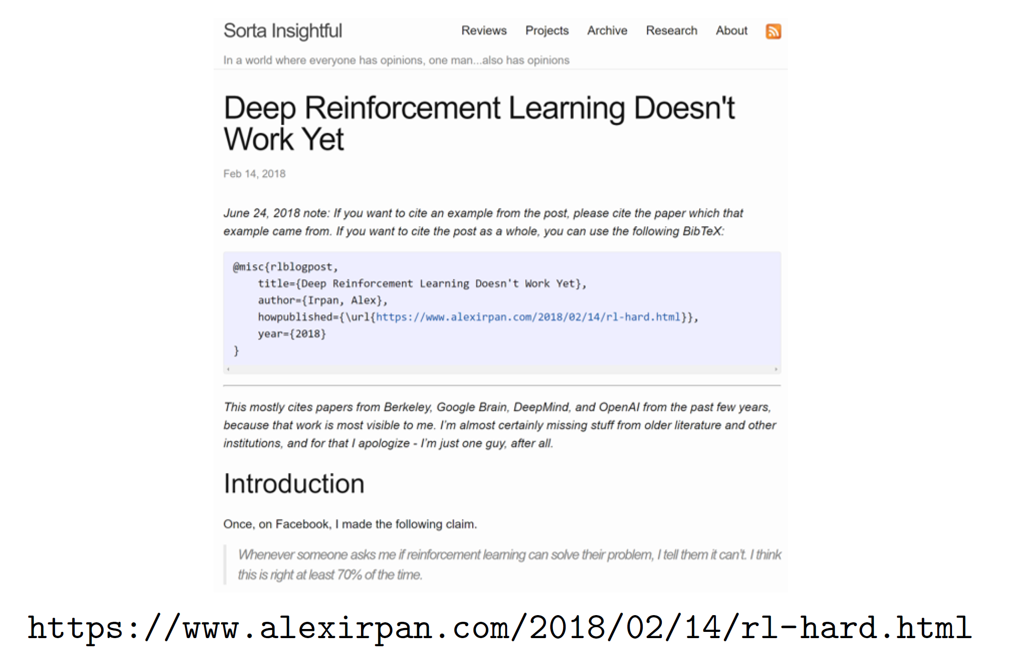
Are we done?

Slide 50
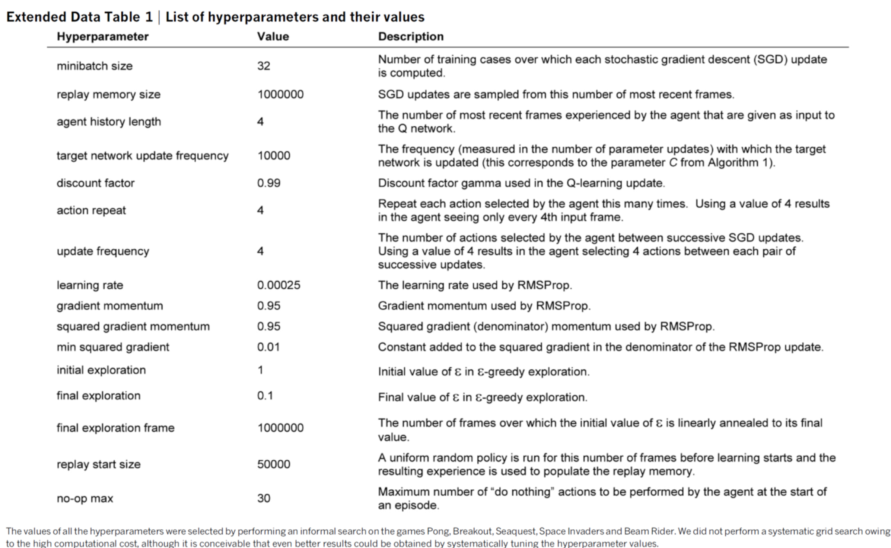
Problem: Hyperparameters (e.g., DQN)

Slide 51
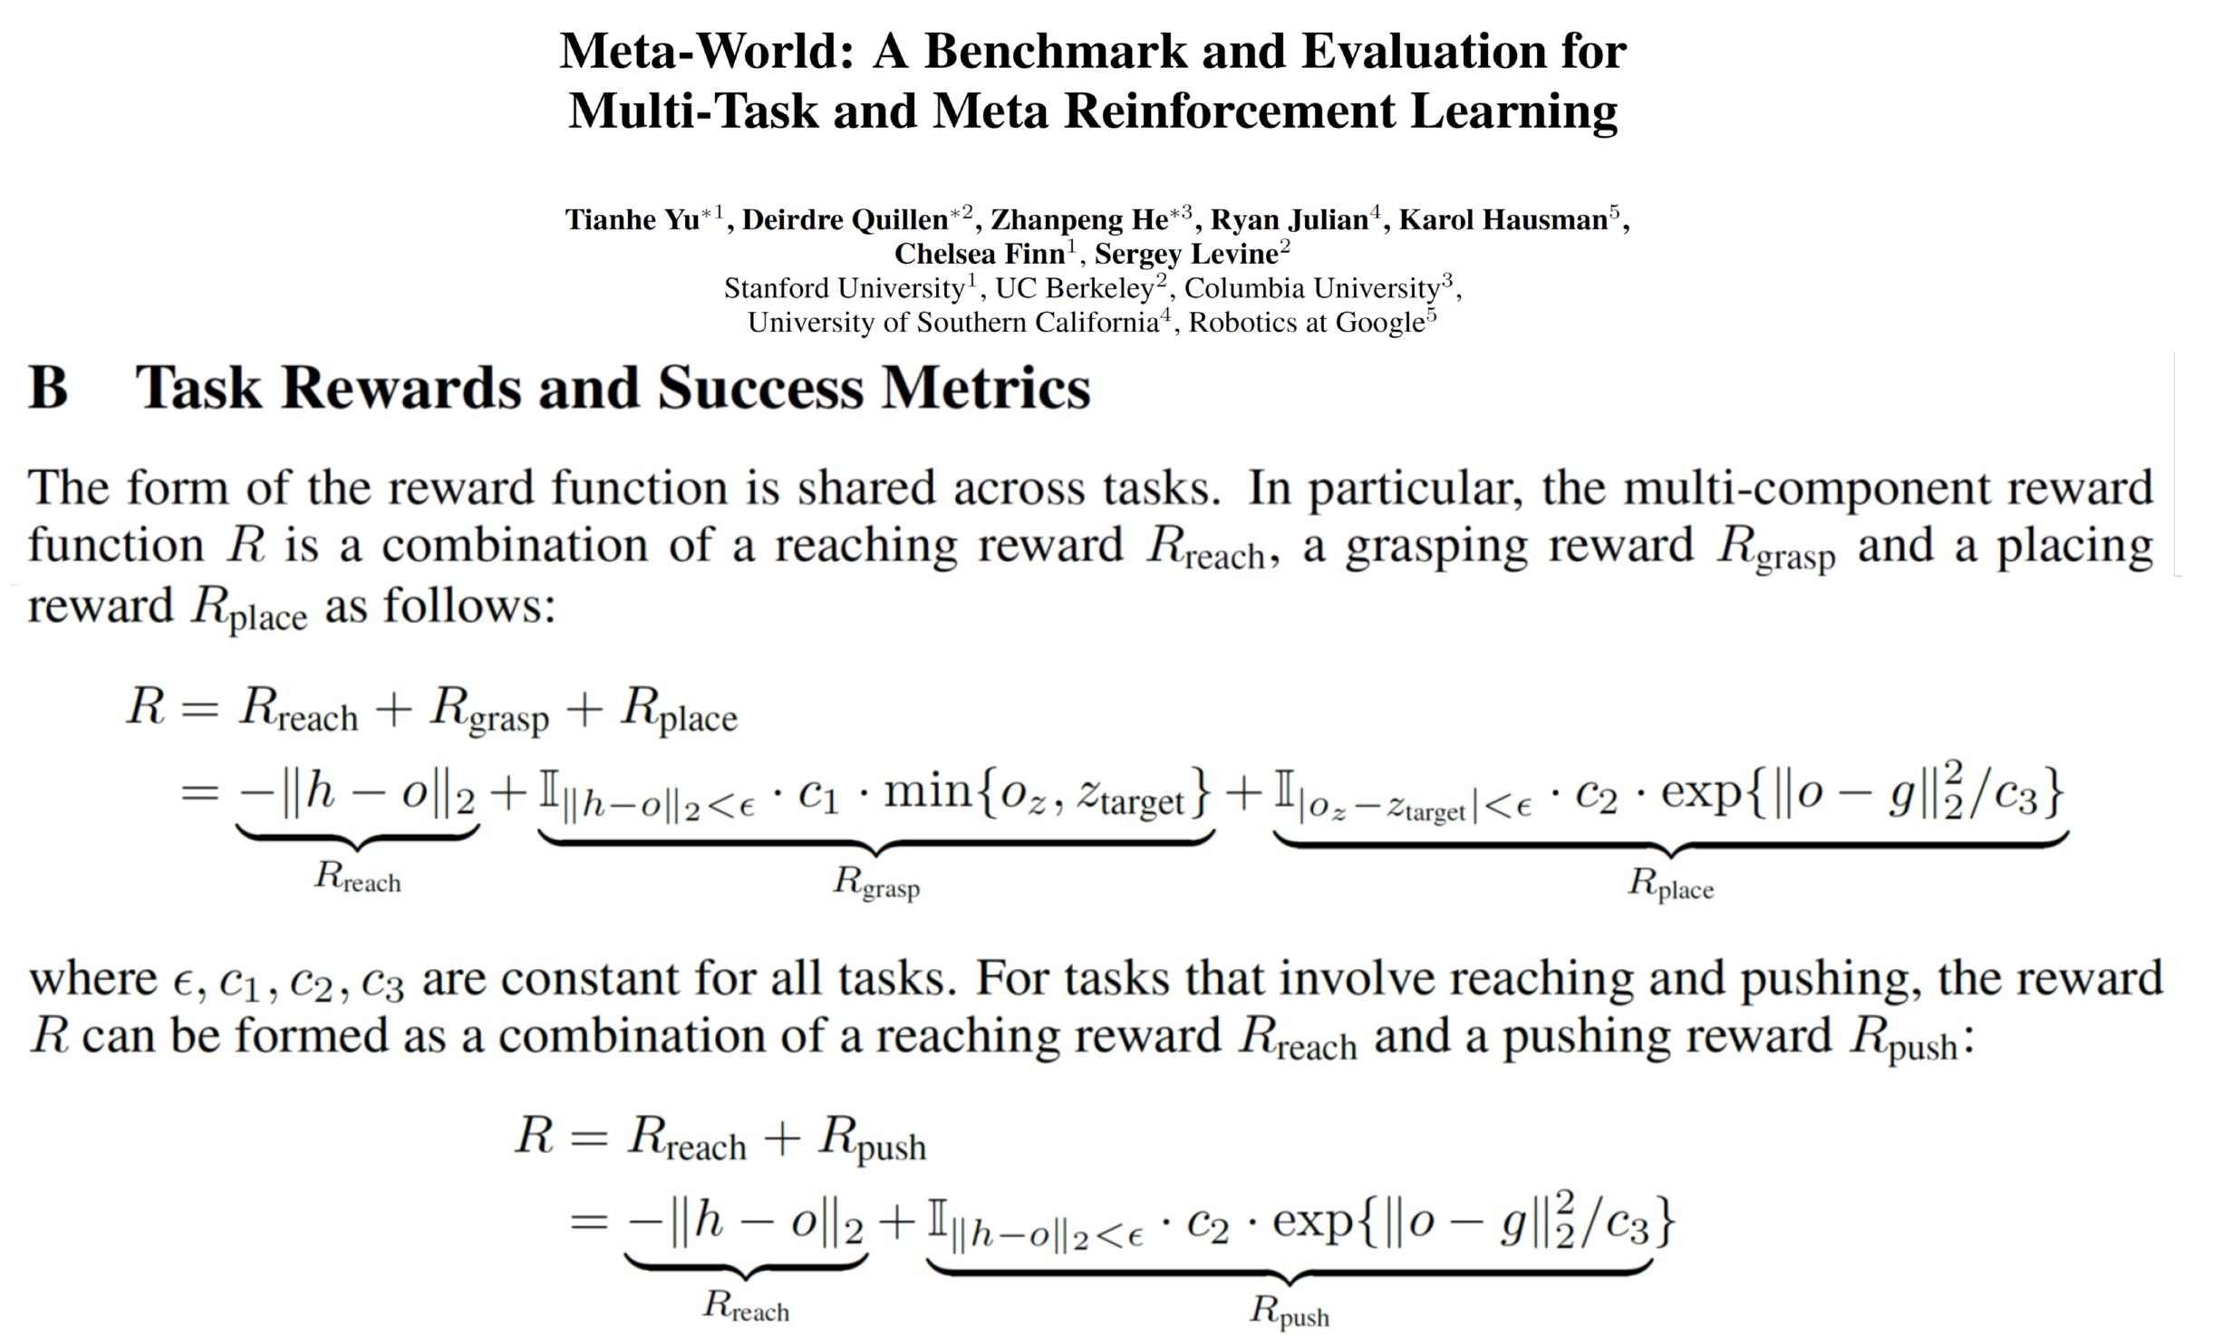
Problem: Reward engineering (+ hyperparameters)
*not picking on these authors specifically!

Slide 52
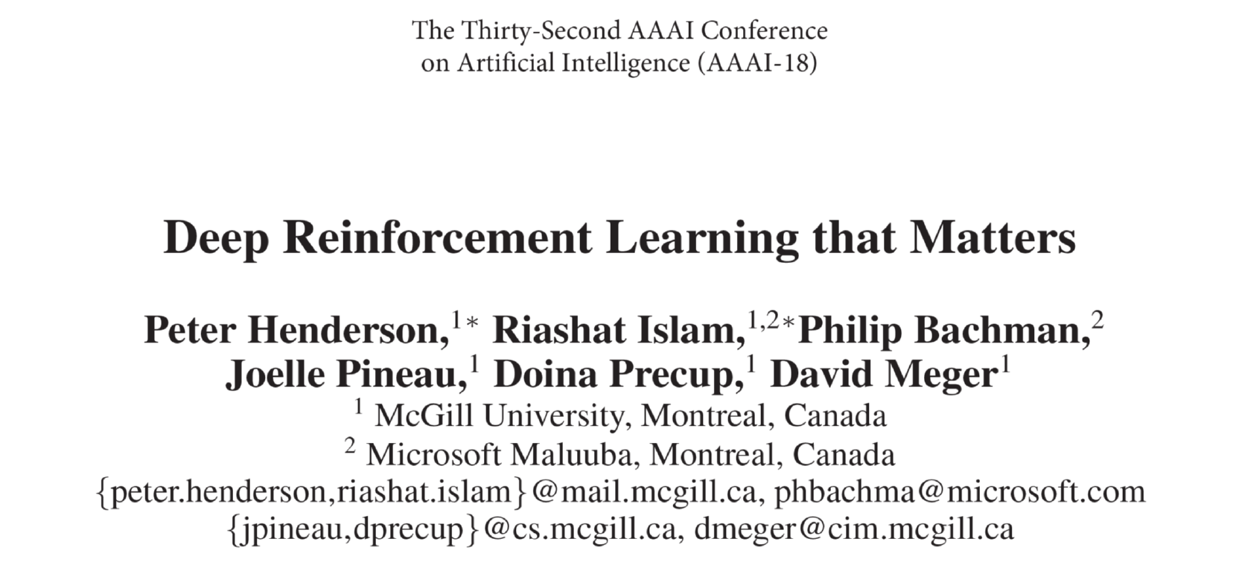
Problem: Algorithmic choices

Slide 53
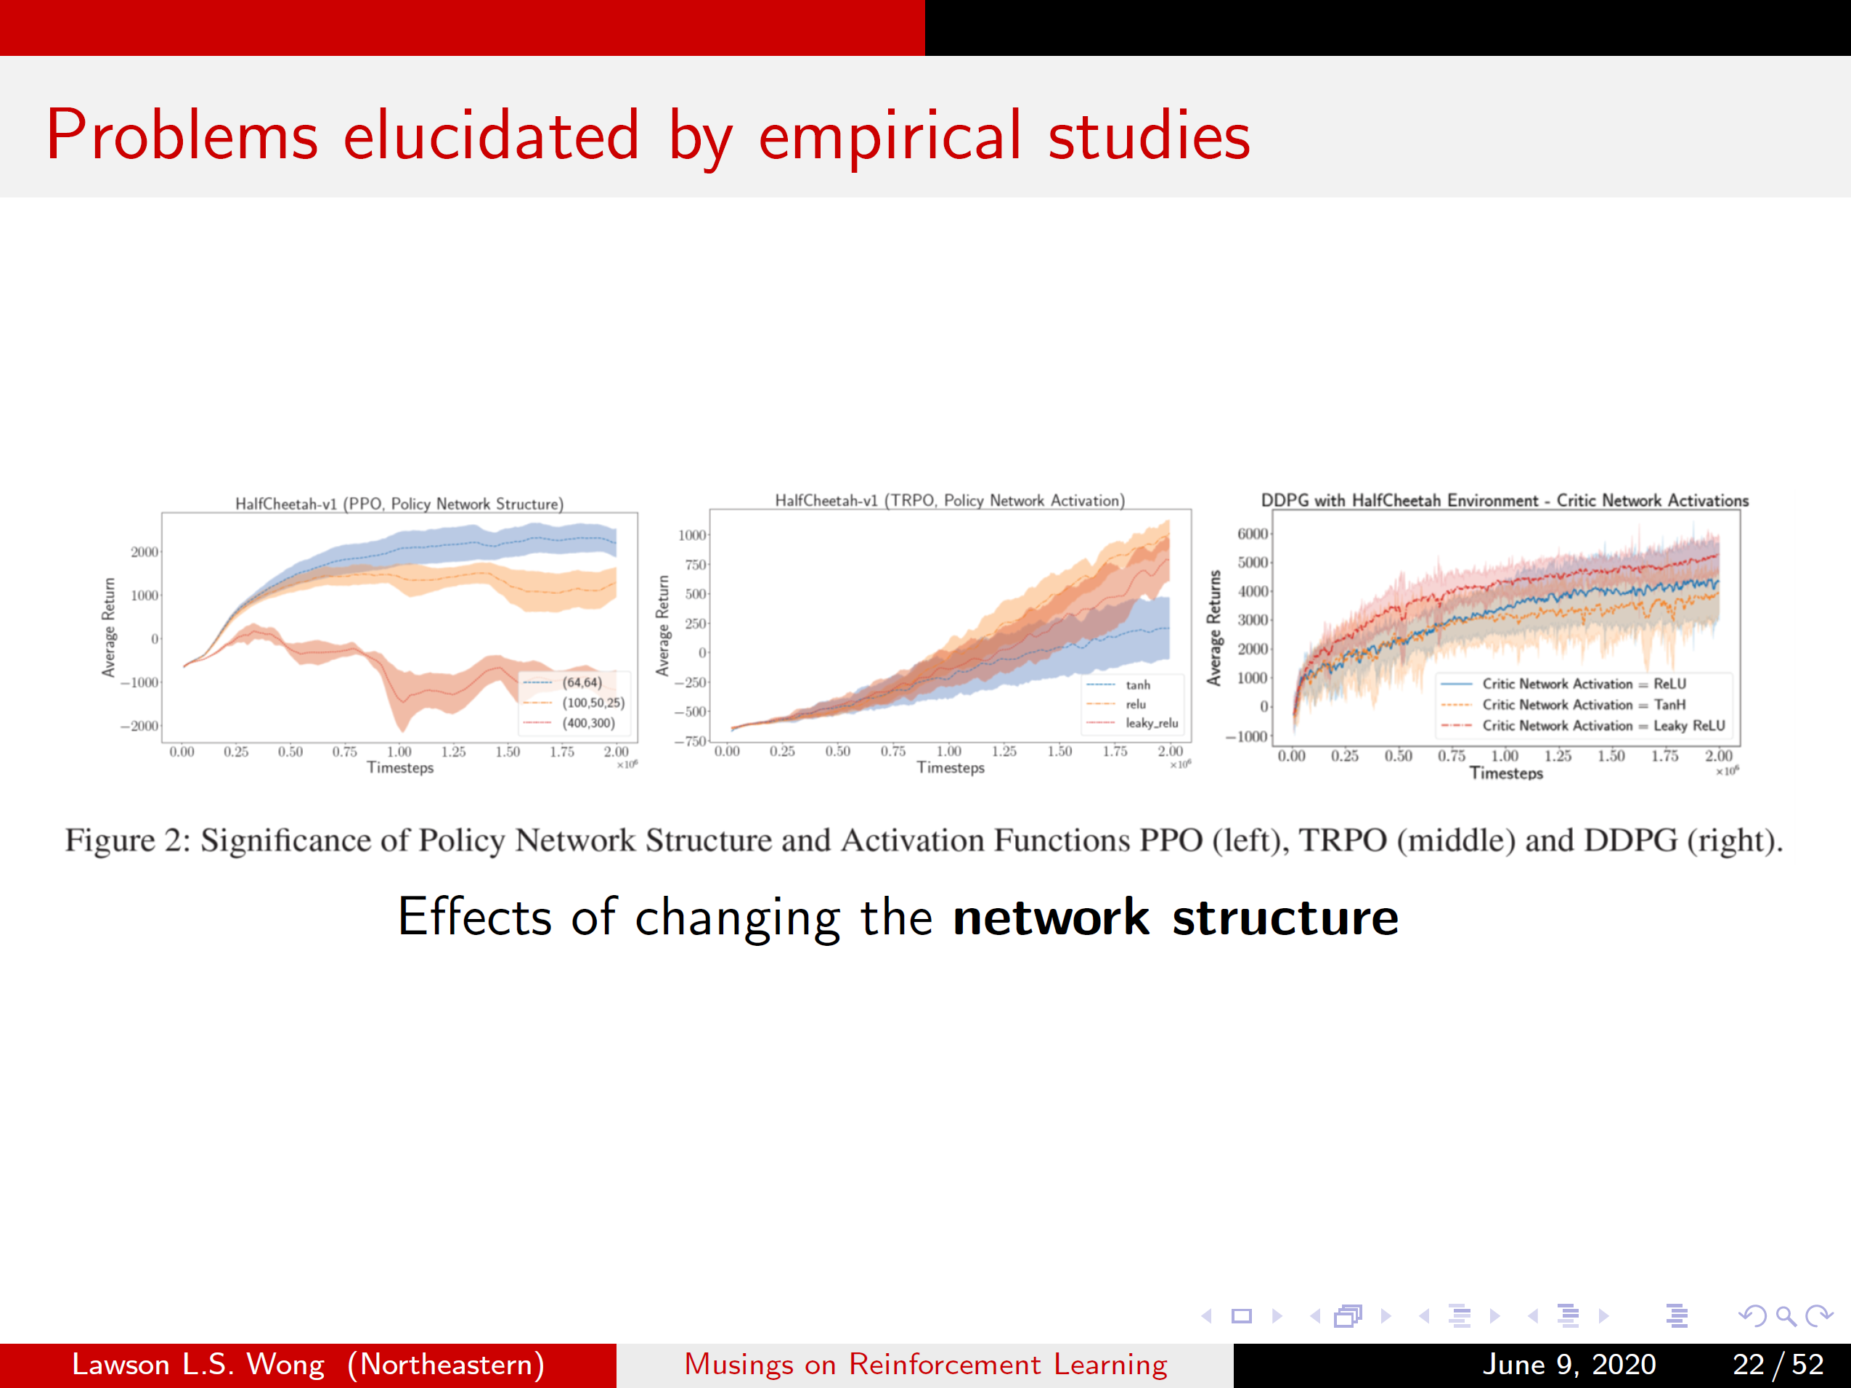
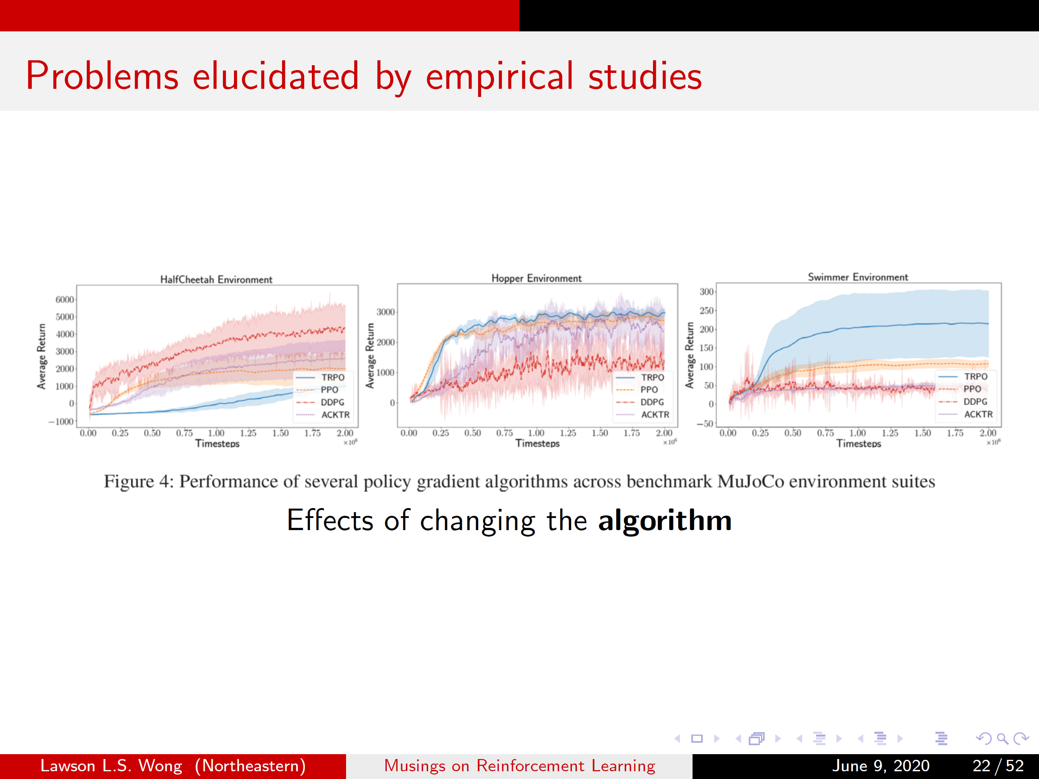
Problem: Algorithmic choices

Slide 54
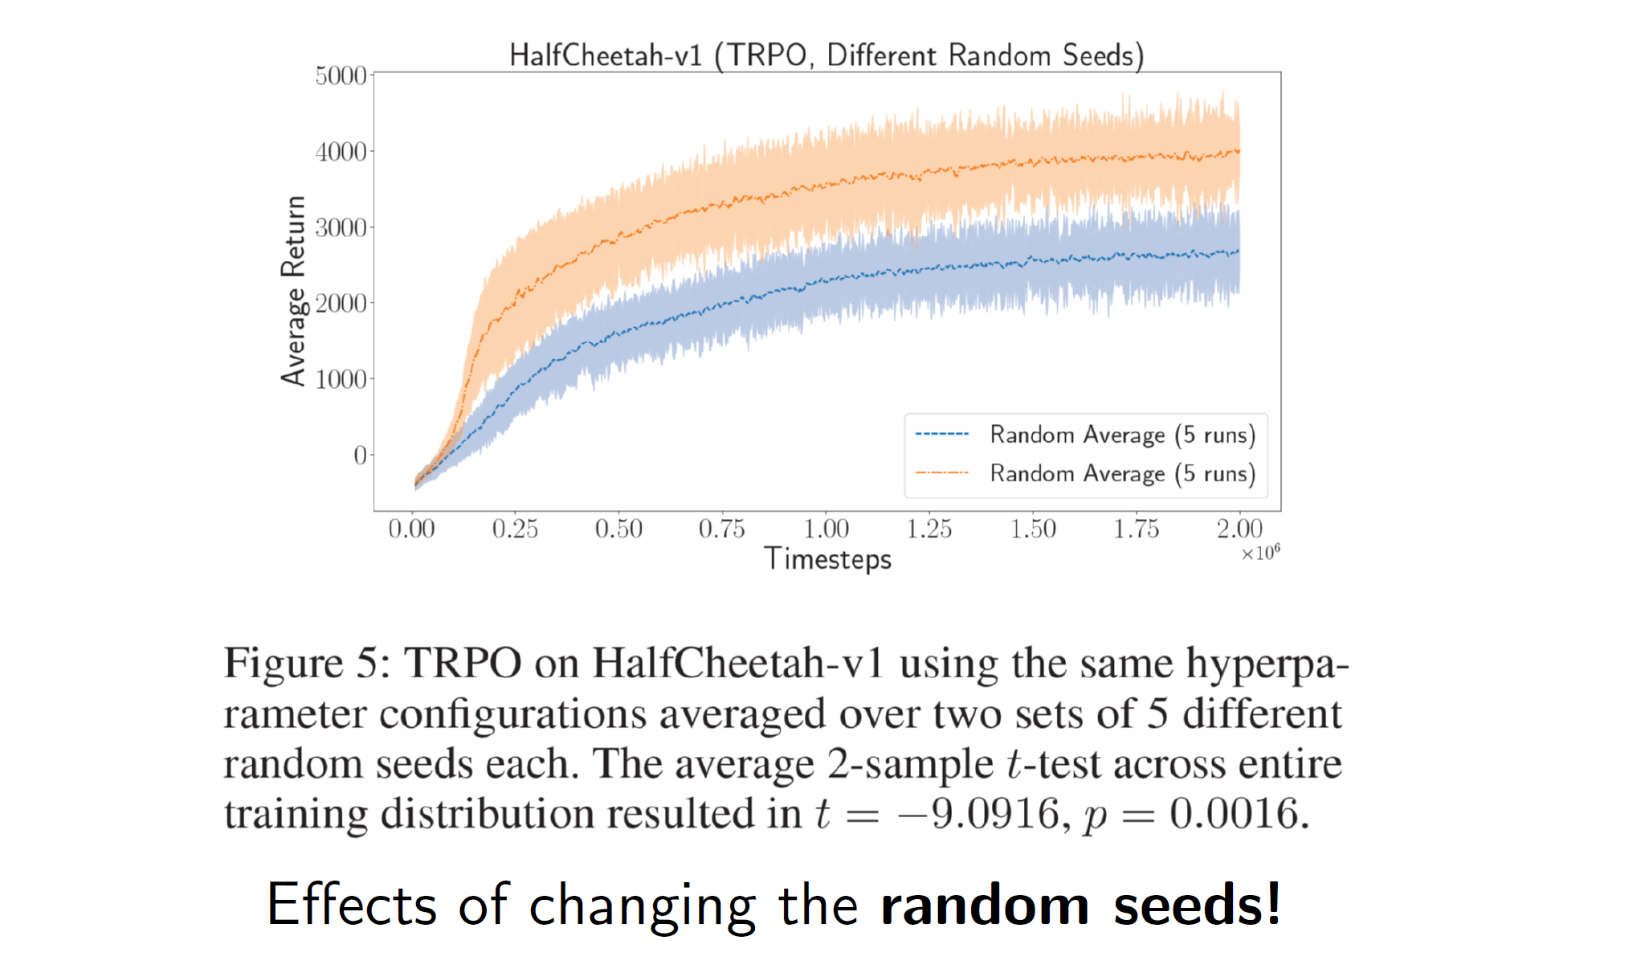
Problem: Algorithmic choices

Slide 55
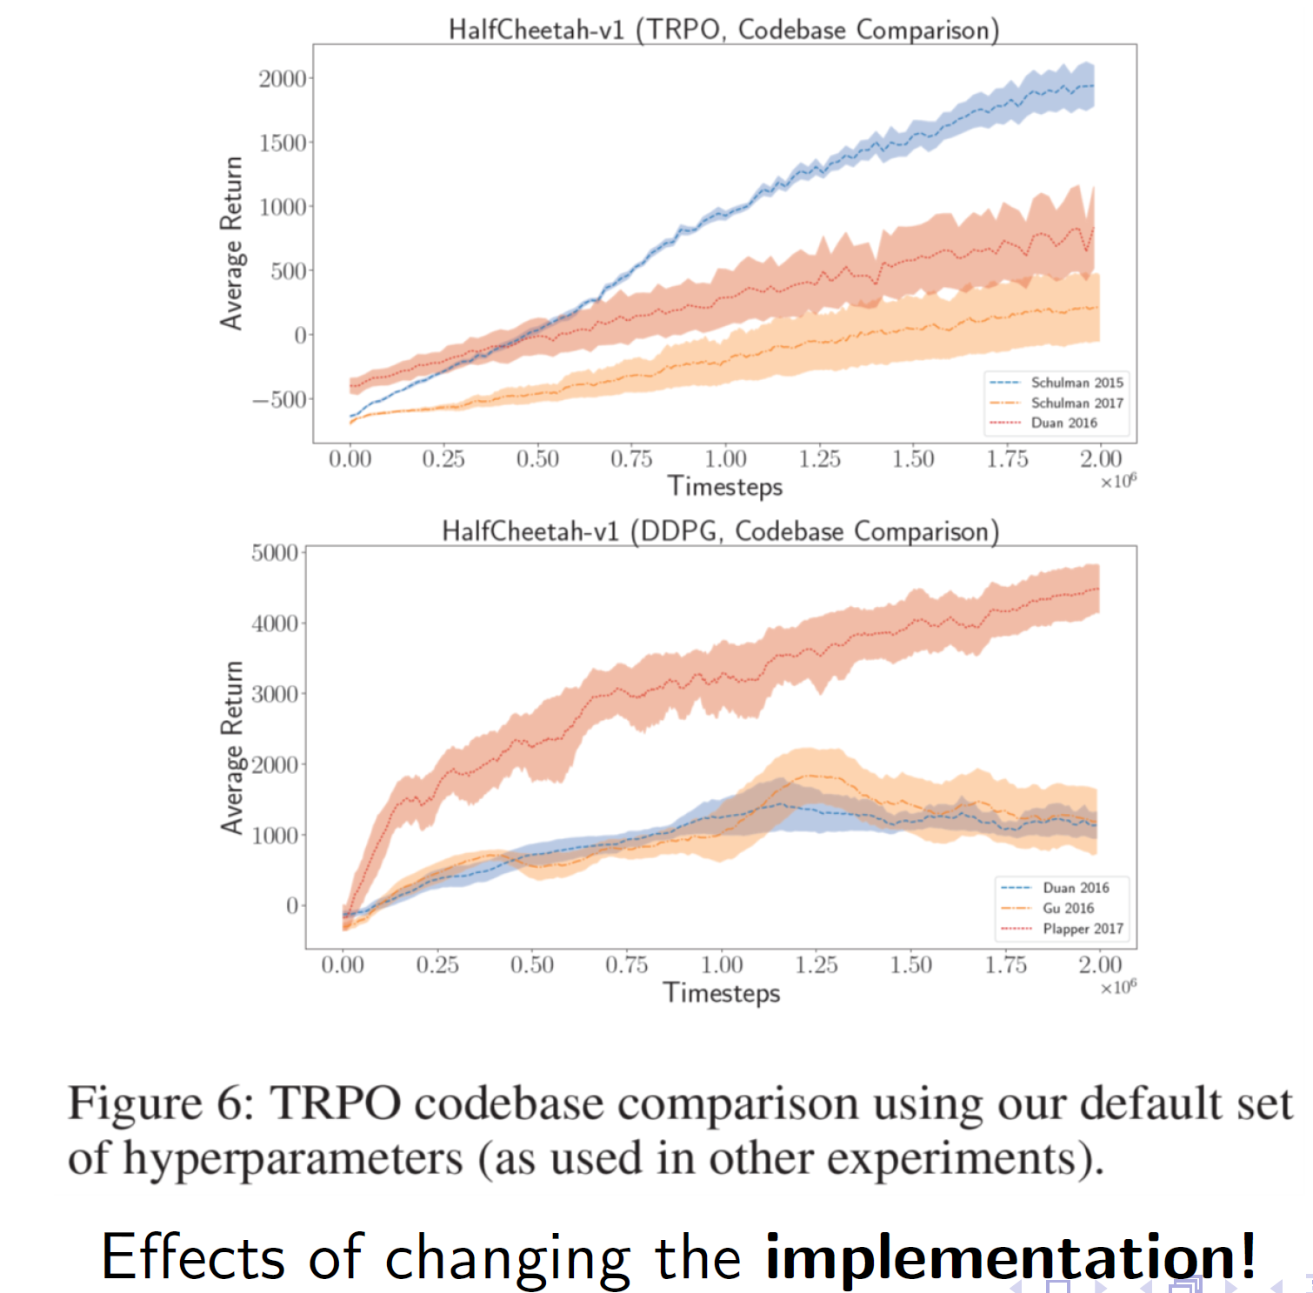
Problem: Algorithmic choices

Slide 56
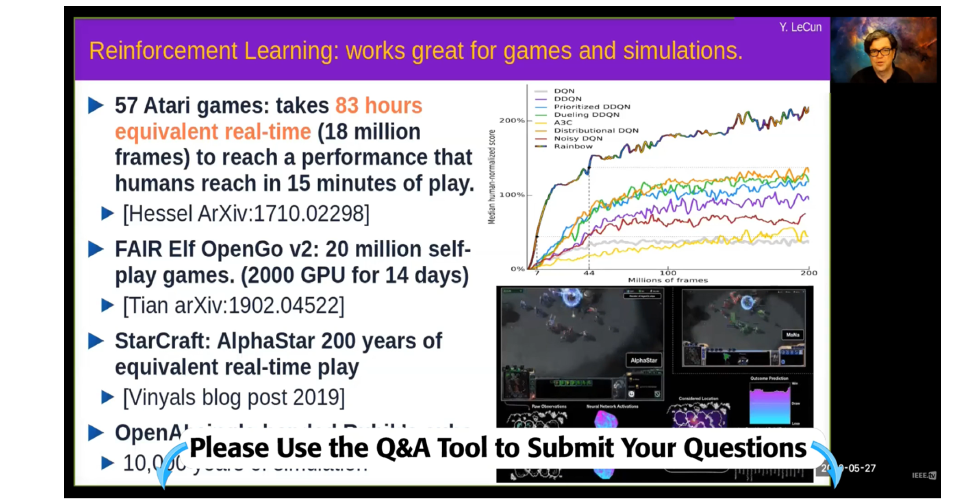
Problem: Sample complexity / learning speed
(OpenAI Five Dota 2 10,000 years of games against itself)
https://ieeetv.ieee.org/self-supervised-learning-world-models-icra-2020
(this slide from about 11m)

Slide 57
Reinforcement learning is very general

Slide 58
Reinforcement learning is very general
Reinforcement learning algorithms are slow because they are so general

Slide 59
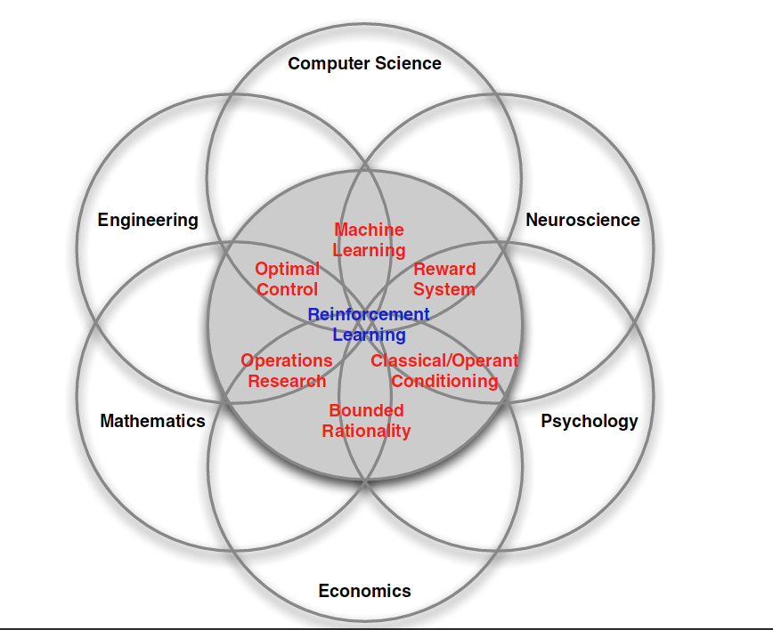
Where does RL live?
Notes:
59

Slide 60
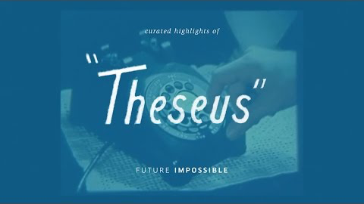
Rat in maze: Theseus (1950’s)

Slide 61
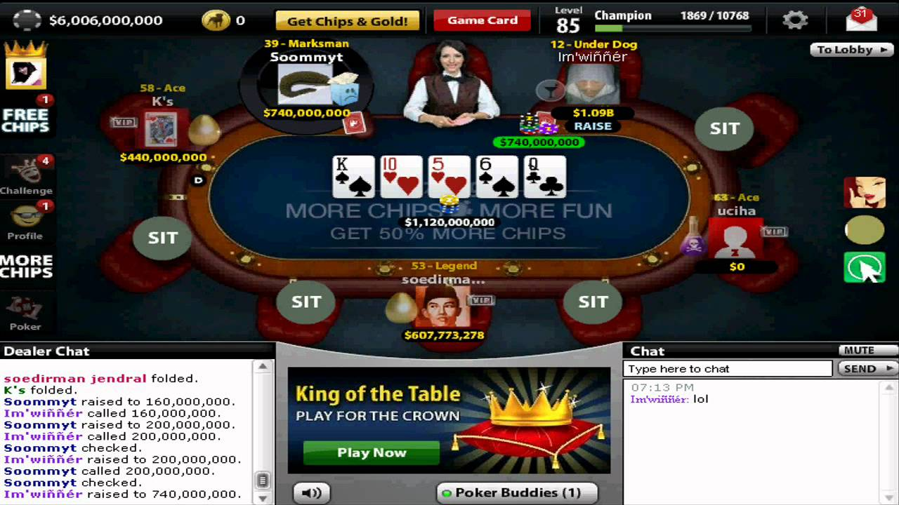
Think-Pair-Share Question
How would you express the
problem of playing online texas
hold-em as an RL problem?
Action = ?
Agent
World
State = ?
Reward = ?
Goal: ?
Notes:
61

Slide 62
Key challenges for RL
no model of the environment
agent only gets a scalar reward signal
delayed feedback
need to balance exploration of the world exploitation of learned knowledge
real world problems can be non-stationary

Slide 63
Major historical RL successes
Learned the world’s best player of Backgammon (Tesauro 1995)
Learned acrobatic helicopter autopilots (Ng, Abbeel, Coates et al 2006+)
Widely used in the placement and selection of advertisements and pages on the web (e.g., A-B tests)
Used to make strategic decisions in Jeopardy! (IBM’s Watson 2011)
Achieved human-level performance on Atari games from pixel-level visual input, in conjunction with deep learning (Google Deepmind 2015)
In all these cases, performance was better than could be obtained by any other method, and was obtained without human instruction
Nowadays (nearly?) every industry is trying to incorporate RL: from autonomous cars to AI assistants
Notes:
63

Slide 64
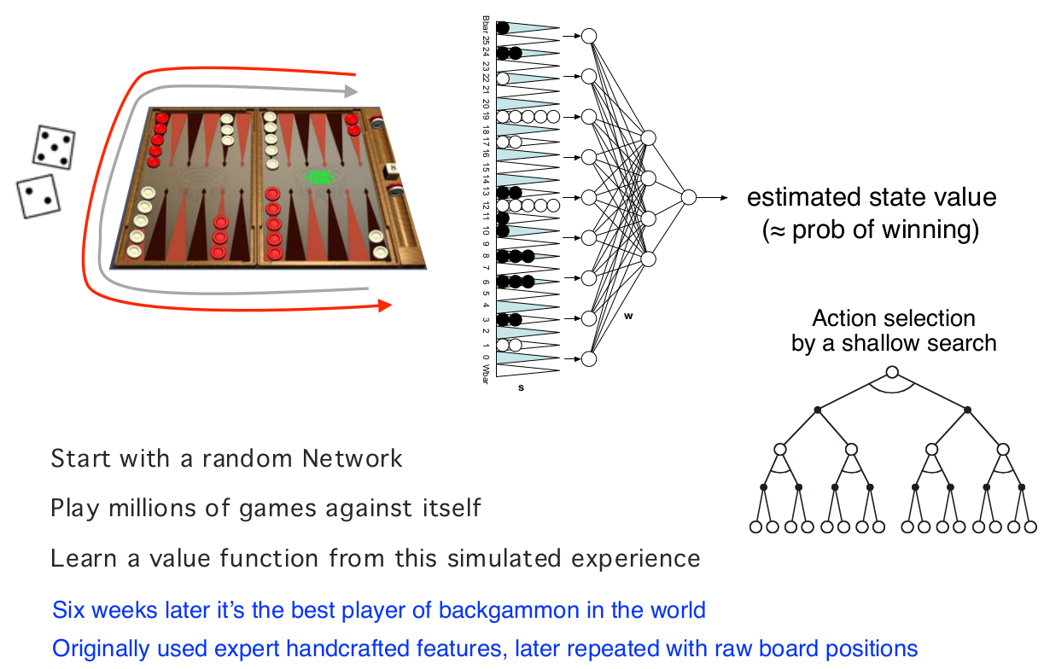
Example: TD-Gammon
Notes:
64

Slide 65
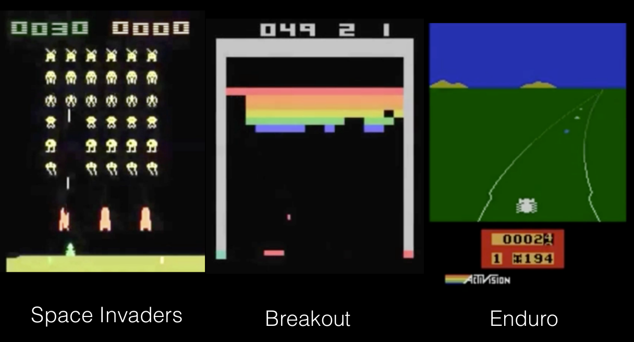
RL + deep learning on Atari games
Notes:
65

Slide 66
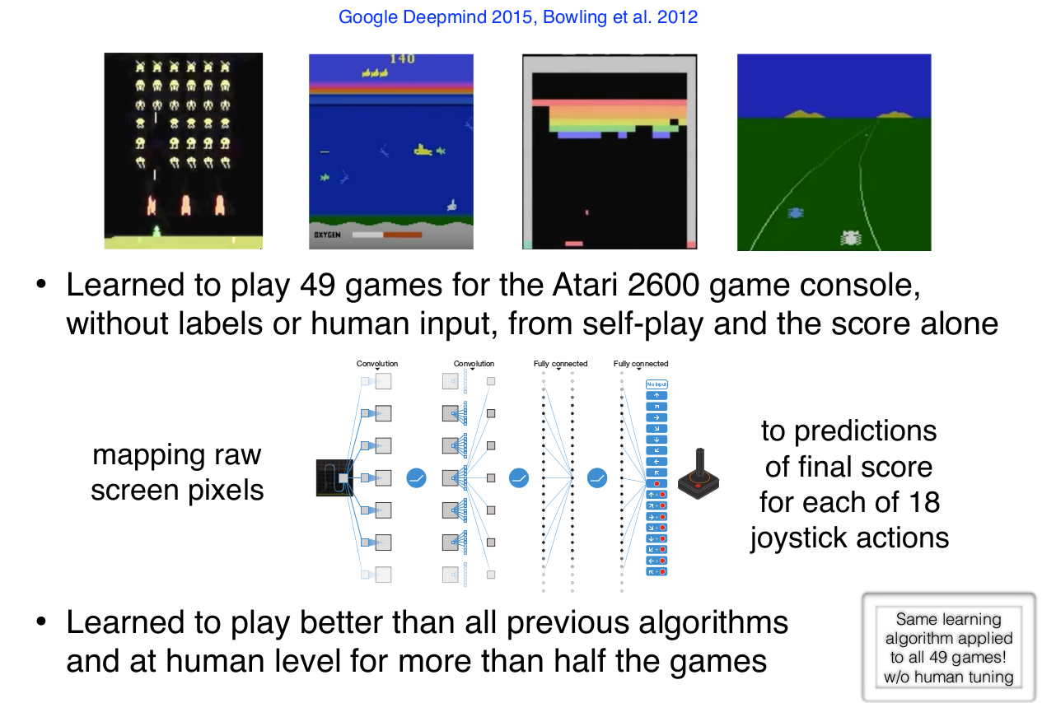
RL + deep learning on Atari games
Notes:
66

Slide 67
Advances in AI abilities are coming faster (last ~10 yrs)
IBM’s Watson beats the best human players of Jeopardy! (2011)
Deep neural networks greatly improve the state of the art in speech recognition and computer vision (2012–)
Google’s self-driving car becomes a plausible reality (≈2013)
Deepmind’s DQN learns to play Atari games at the human level, from pixels, with no game-specific knowledge (≈2014, Nature)
University of Alberta’s Cepheus solves (heads-up limit) Poker (2015, Science)
Google Deepmind’s AlphaGo defeats the world Go champion, vastly improving over all previous programs (2016)
CMU’s Pluribus can beat top humans at 6 player no-limit poker (2019, Science)
Notes:
67

Slide 68
Think-Pair-Share question
When will we understand the principles of intelligence well enough
to create, using technology, artificial minds that rival our own in skill
and generality?
Which of the following best represents your current views?
A. Never
B. Not during your lifetime
C. During your lifetime, but not before 2045
D. Before 2045
E. Before 2035
F. It’s already happened and we’re all living in a simulation
What do you think happens after that?
Notes:
68

Slide 69
This course
Content:
Most of the material comes from Sutton and Barto’s book, Reinforcement Learning: an Introduction, second ed
We will also cover selected topics in deep RL not covered in that book.
Objectives:
Understand theoretical underpinnings of RL
Gain practical knowledge of how to solve problems using RL
Notes:
69

Slide 70
This course
Prerequisites:
you need to be able to write Python code and install PyTorch
need to be “mathematically mature”, i.e. be able to understand concepts explained mathematically
background in probability, calculus and linear algebra
Self assessment:
Handout and online
Solutions will be available next week
Notes:
70

Slide 71
Next time
Bandits (the simplest RL setting)!
Start exercise 0 and do self assessment!

